Slide 1

Dynamic 3D Structure and Gene Regulation of Drosophila under Heat Stress
Presenter: Yin Pengfei
Instructor: Zheng Meizhen
Time: 2023 Nov 18th, 11:50 - 12:05

Slide 2
Background
Brief introduction to 3D genomics
Commonly used techniques in 3D genomics

Slide 3
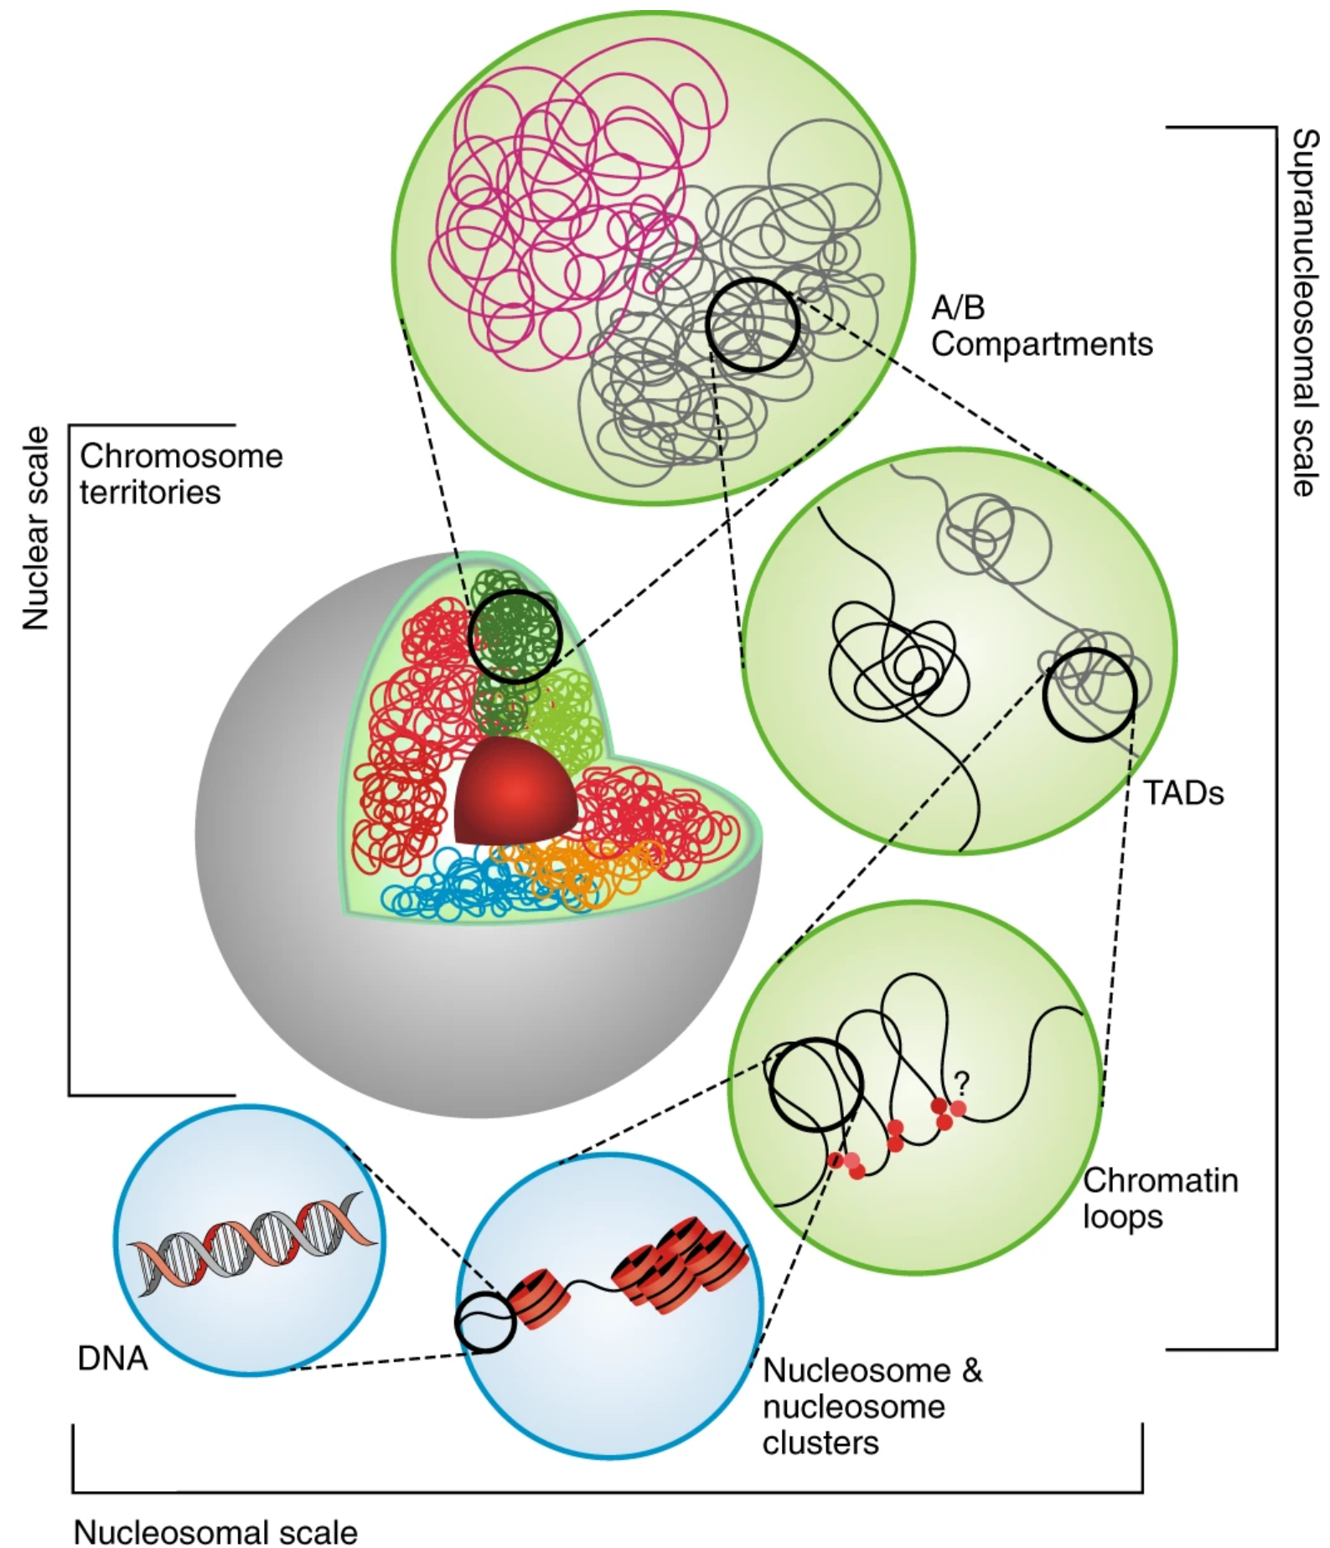
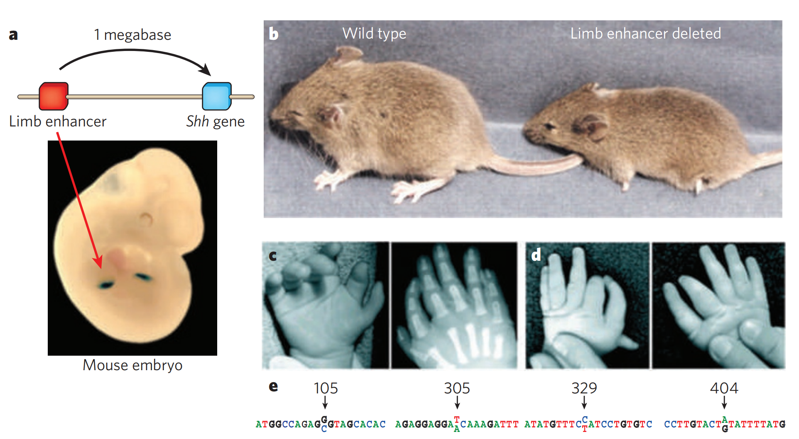
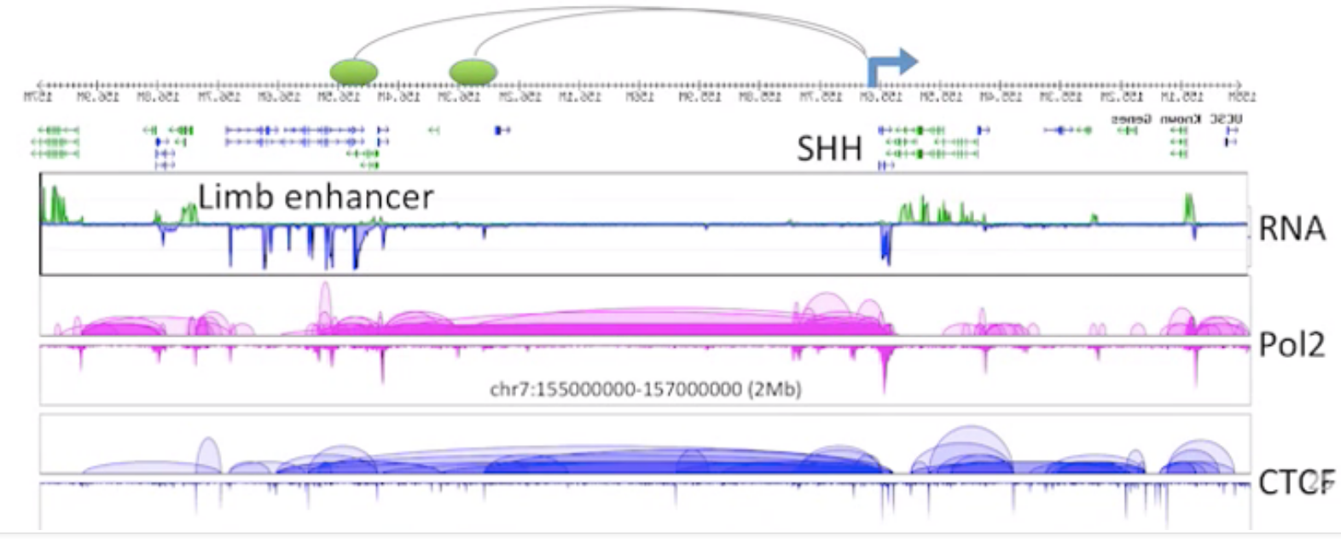
Background
3D genomics, a new branch of epigenetics
Visel et al., Nature. 2009
Limb enhancer and shh gene are spatially close
Shh
RNA-seq
Limb enhancer
ChIA-PET RNAPII
Doğan et al., Nature Plants. 2018
chr7:155000000-157000000(2Mb)
ChIA-PET CTCF
The essence: some contacts of DNA fragments are involved in gene expression and regulation
From Yijun Lab

Slide 4
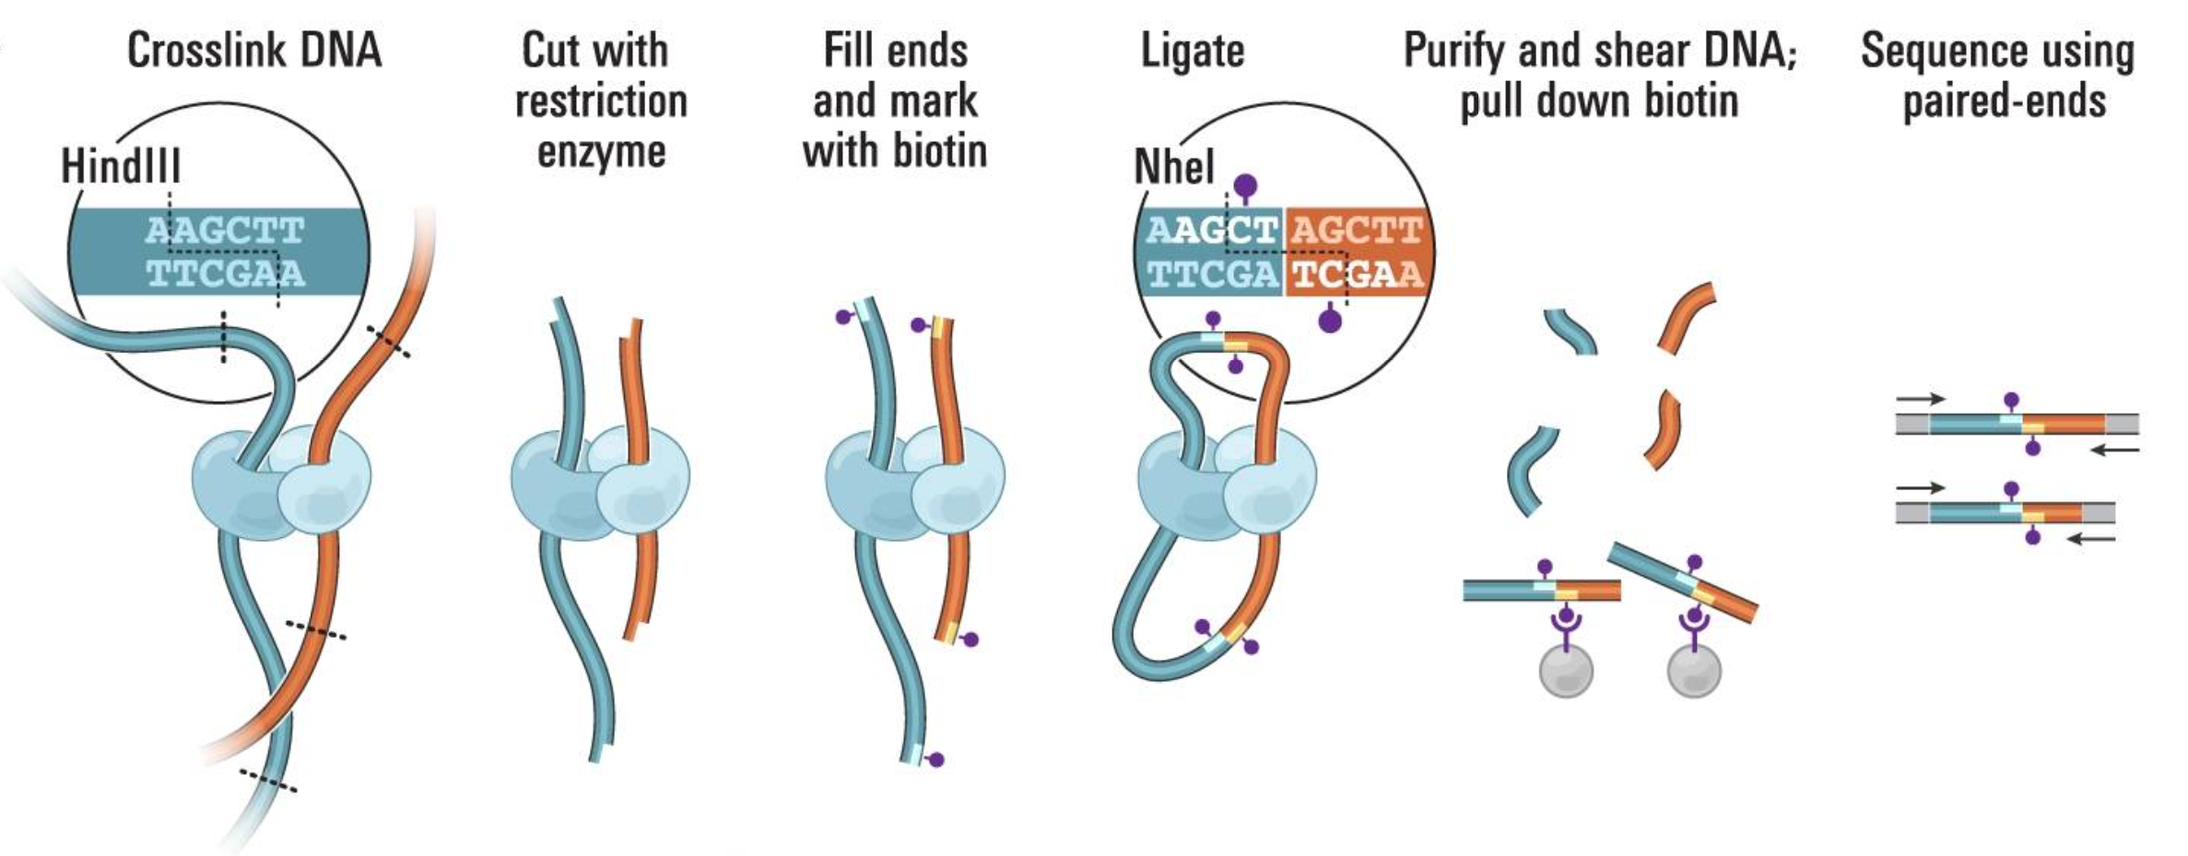
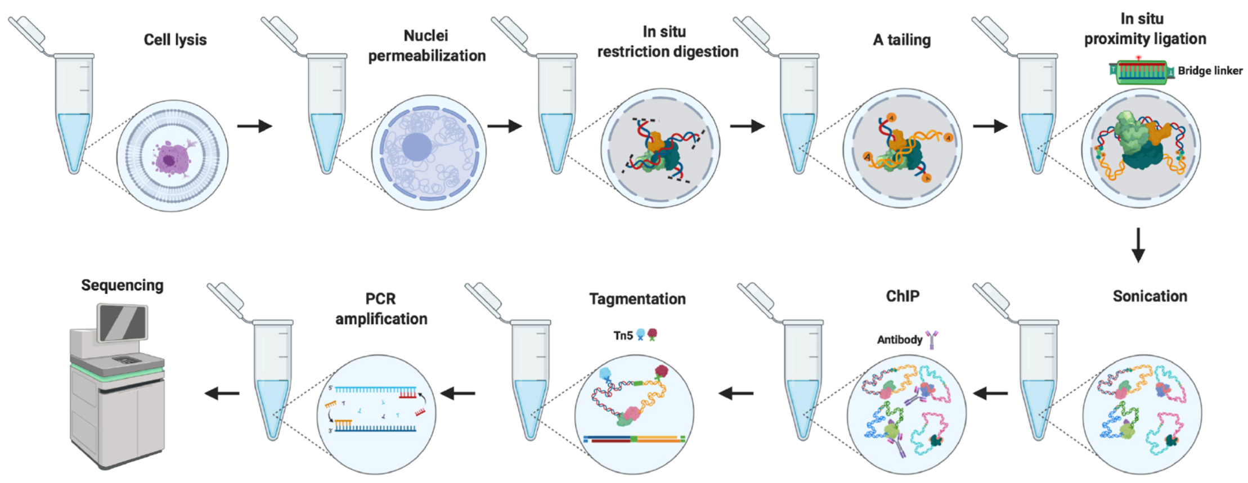
Background
Commonly used techniques in 3D genomics
Commonly used sequencing-based techniques in 3D genomics
Erez et al., Science. 2009
Hi-C
ChIA-PET is roughly equal to proximity ligation (capture the chromatin interaction) plus ChIP
Wang et al., Curr Protoc. 2021
in situ ChIA-PET

Slide 5
Project design

Slide 6
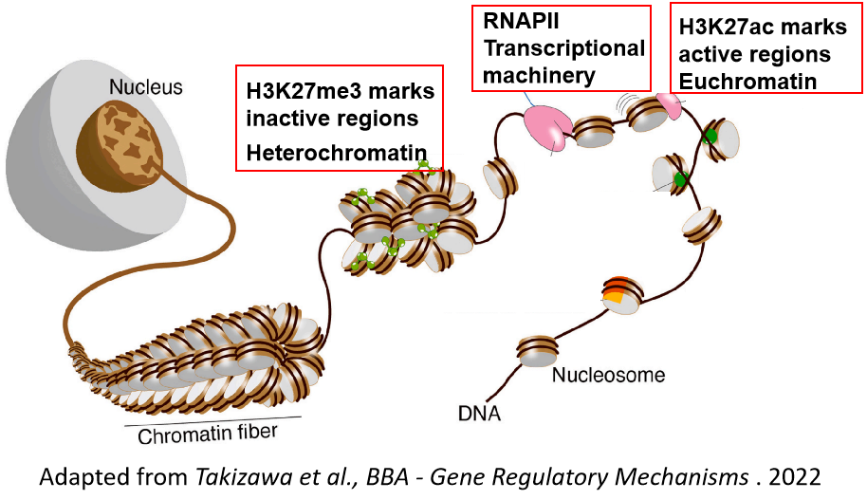
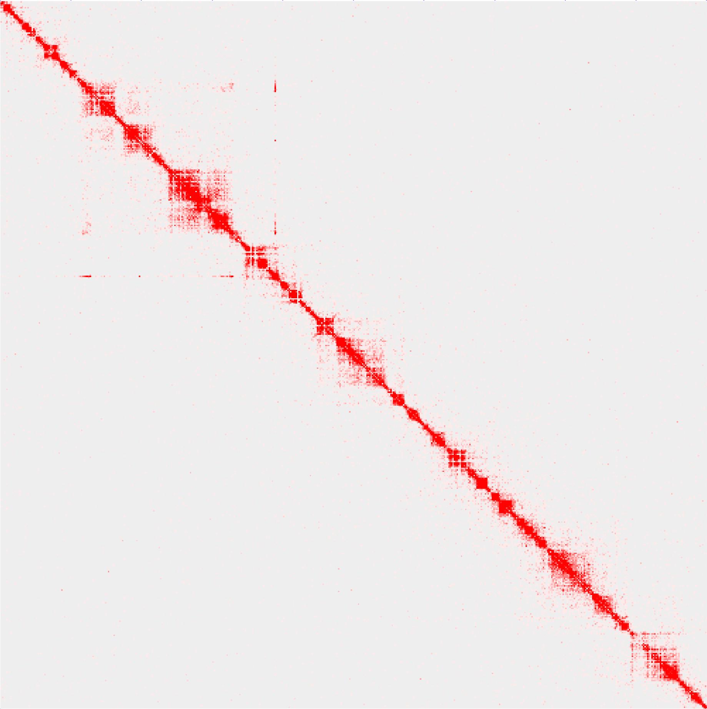
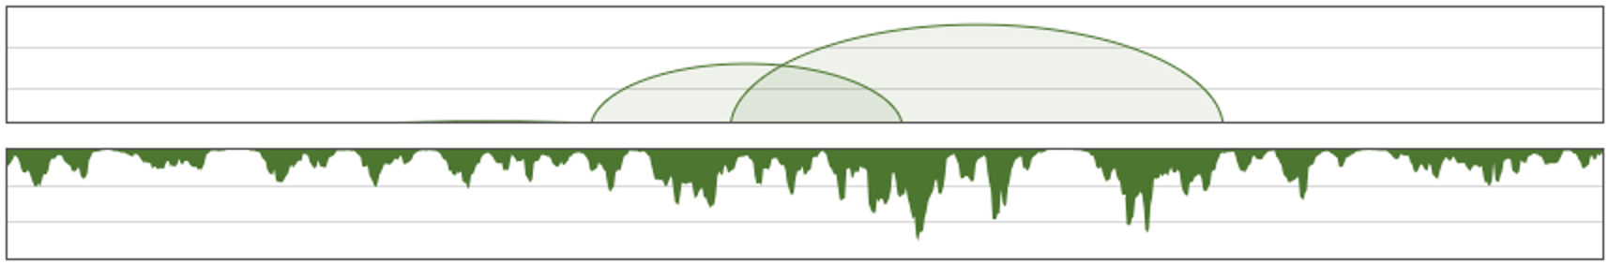
Project design
S2 cell line
Wild type (WT)
Data format produced by ChIA-PET
Heat shock (HS) treatment
37℃, 20mins
Hi-C matrix
Loops and coverage
RNA-seq
loops
WT
HS
coverage
H3K27me3 ChIA-PET
H3K27ac ChIA-PET
RNAPII
ChIA-PET
RNA-seq
Compartments/TADs
Interaction domains/Loops
H3K27me3
H3K27ac
H3K27me3 mediated chromatin interaction
H3K27ac
mediated chromatin interaction
RNAPII
mediated chromatin interaction
Gene expression
Changes at different levels of 3D structure
induced by heat shock
Genome of Drosophila can roughly be divided into H3K27me3 and H3K27ac regions
H3K27me3: inactive histone mark
H3K27ac: active histone mark
RNAPII: transcriptional machinery protein
RNA-seq: mark the gene expression level
Dynamic 3D structure and gene regulation of Drosophila under heat stress

Slide 7
Data quality
Successful heat shock treatment
Reproducibility of ChIA-PET libraries

Slide 8
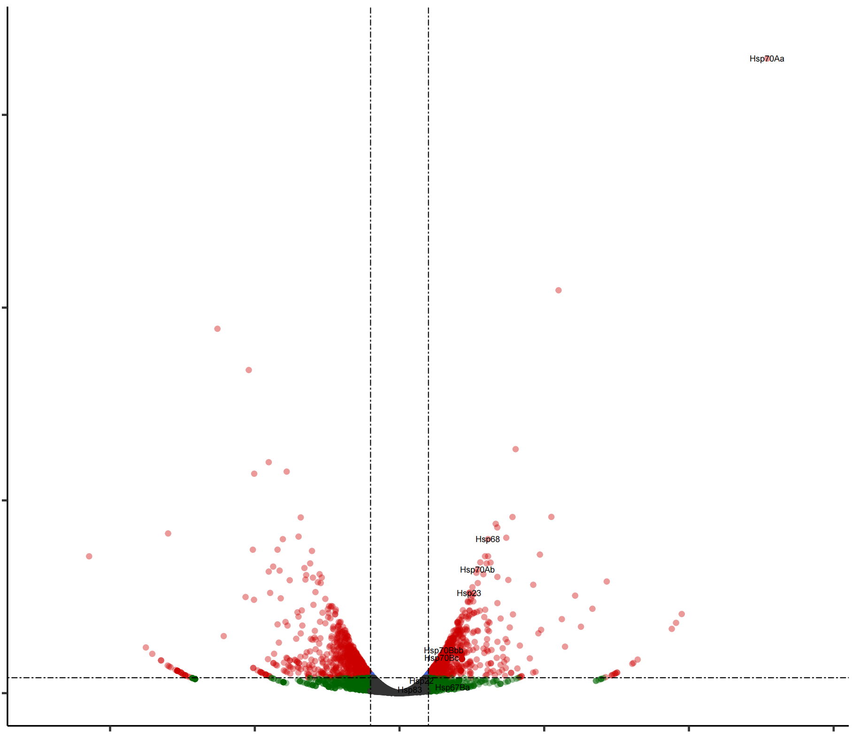
Data quality
Typical DEGs related to heat shock show the success of heat shock treatment
Hsp70Aa
-Log₁₀ FDR
0 50 100 150
Hsp68
Hsp70Ab
Hsp23
Hsp70Bbb
Hsp70Bc
-10 -5 -1 0 1 5 10 15
Log₂ FC
expressed n= 8270
up-regulated n= 1054
down-regulated n= 988
Produced by Deng Yuqing and Yin Pengfei

Slide 9
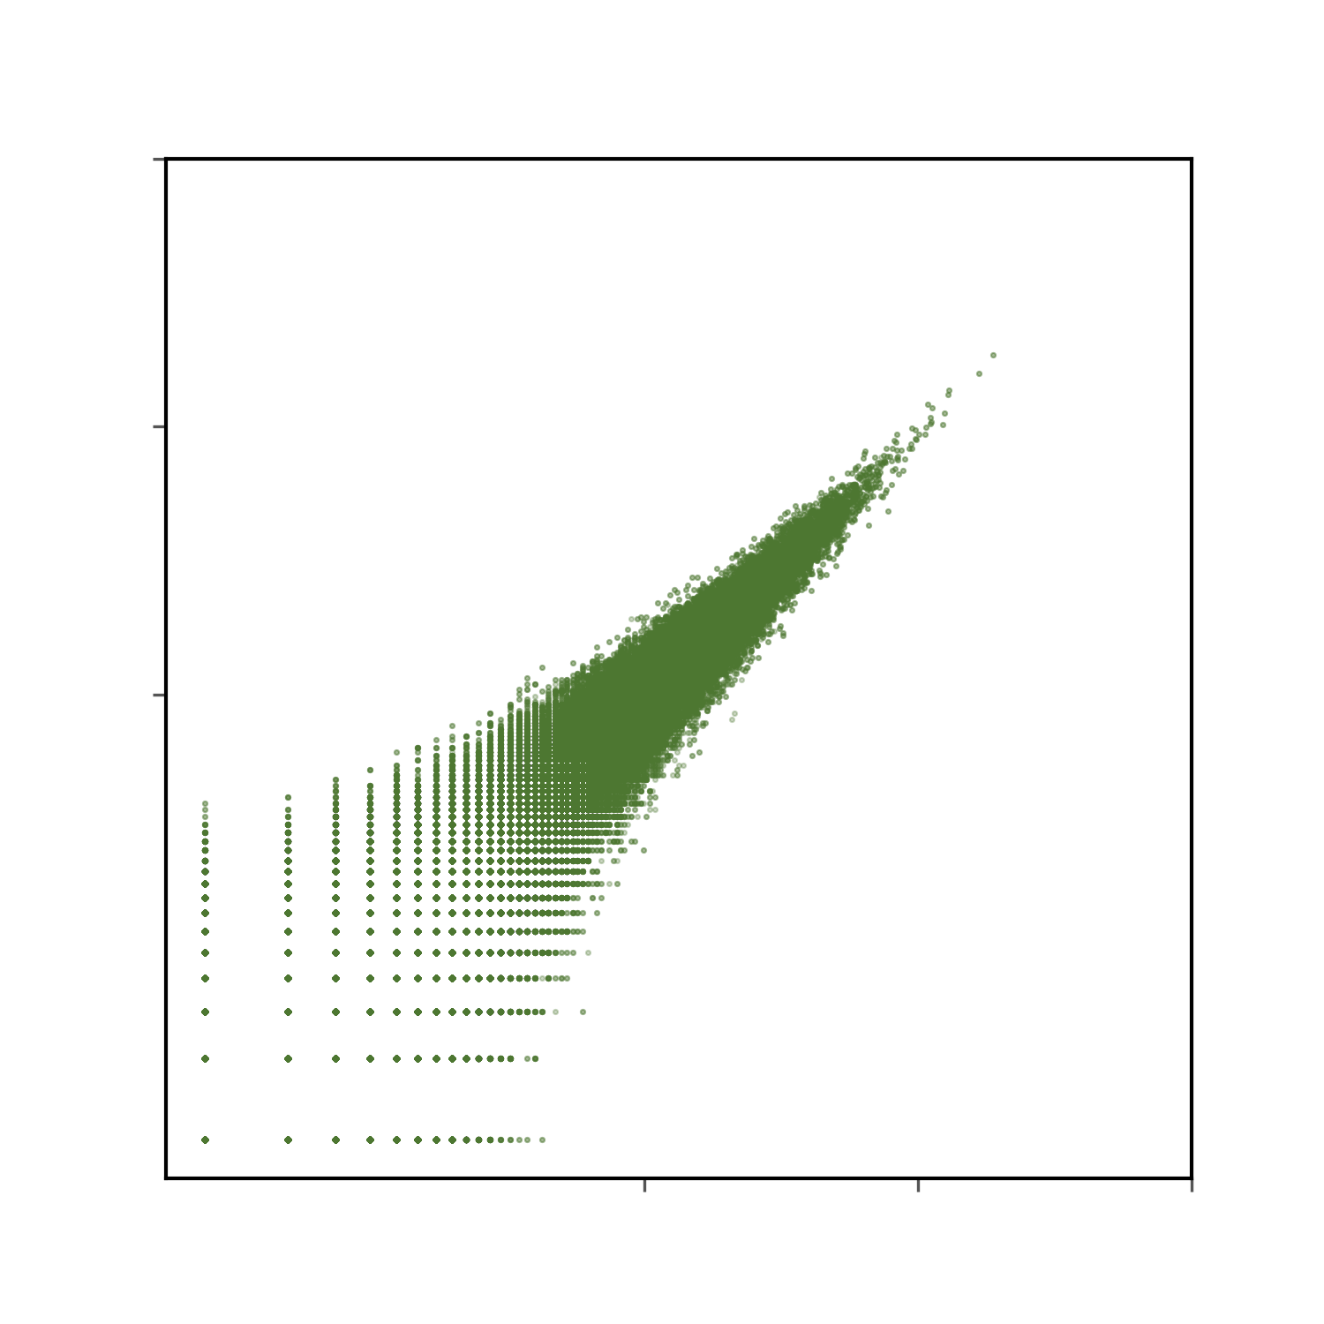
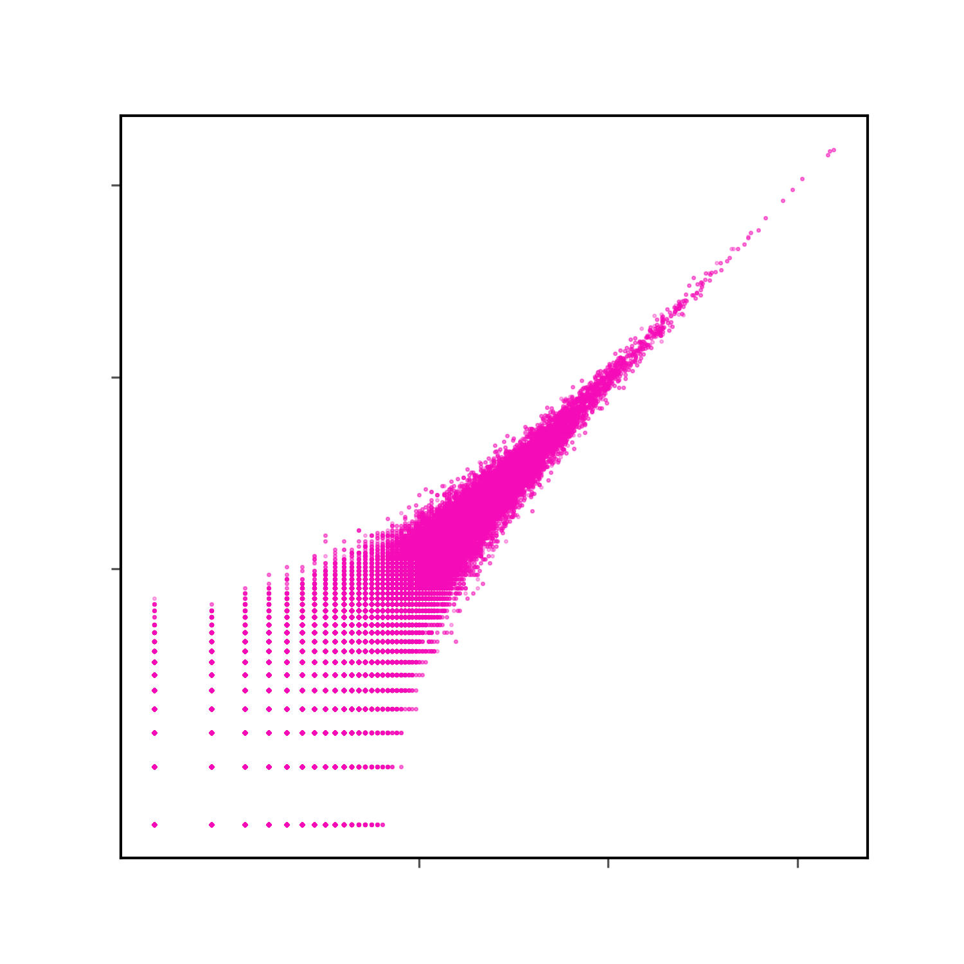
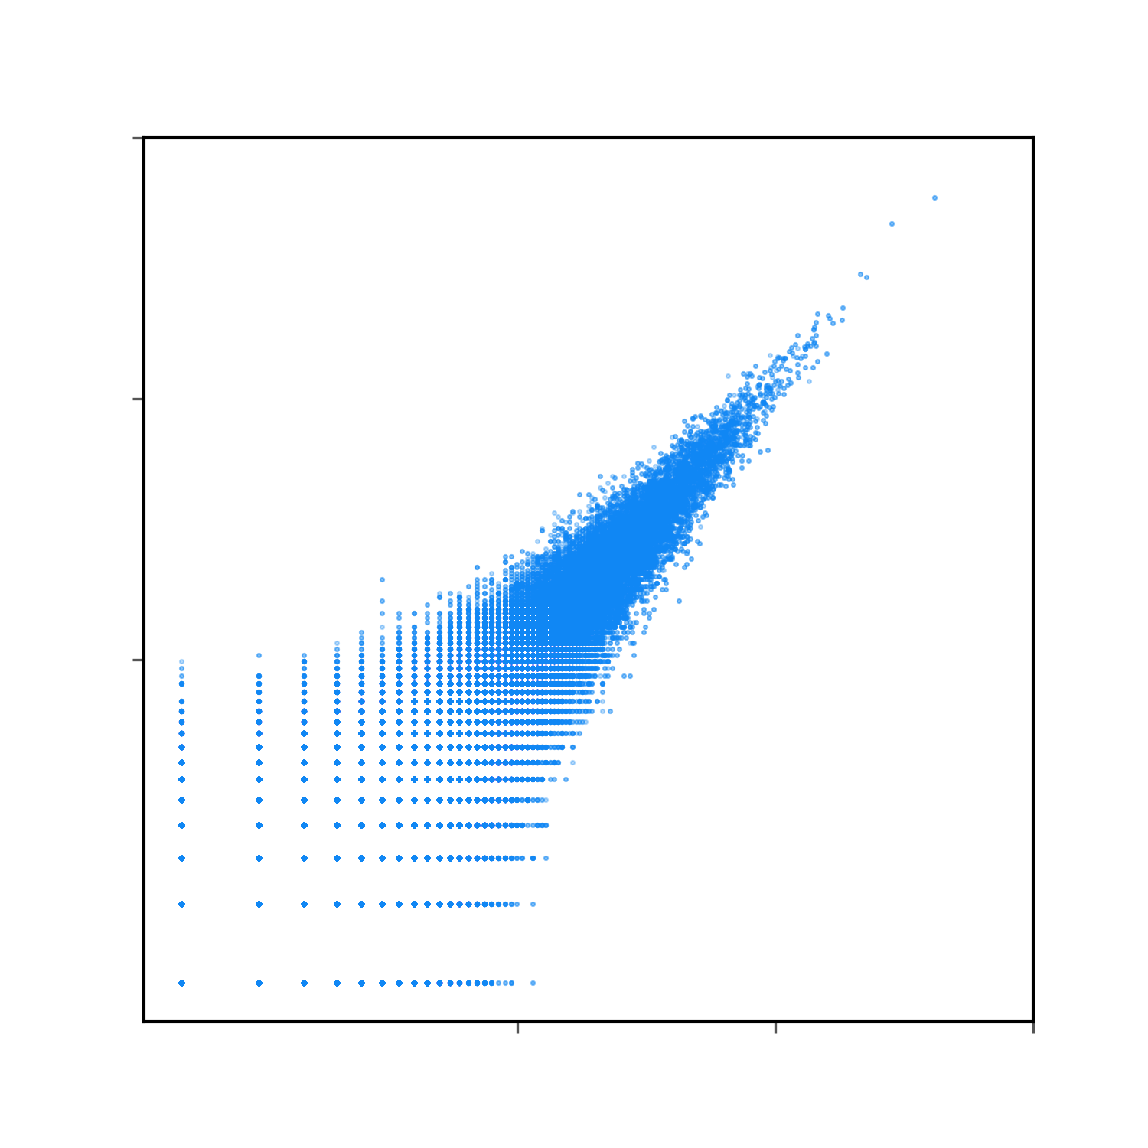
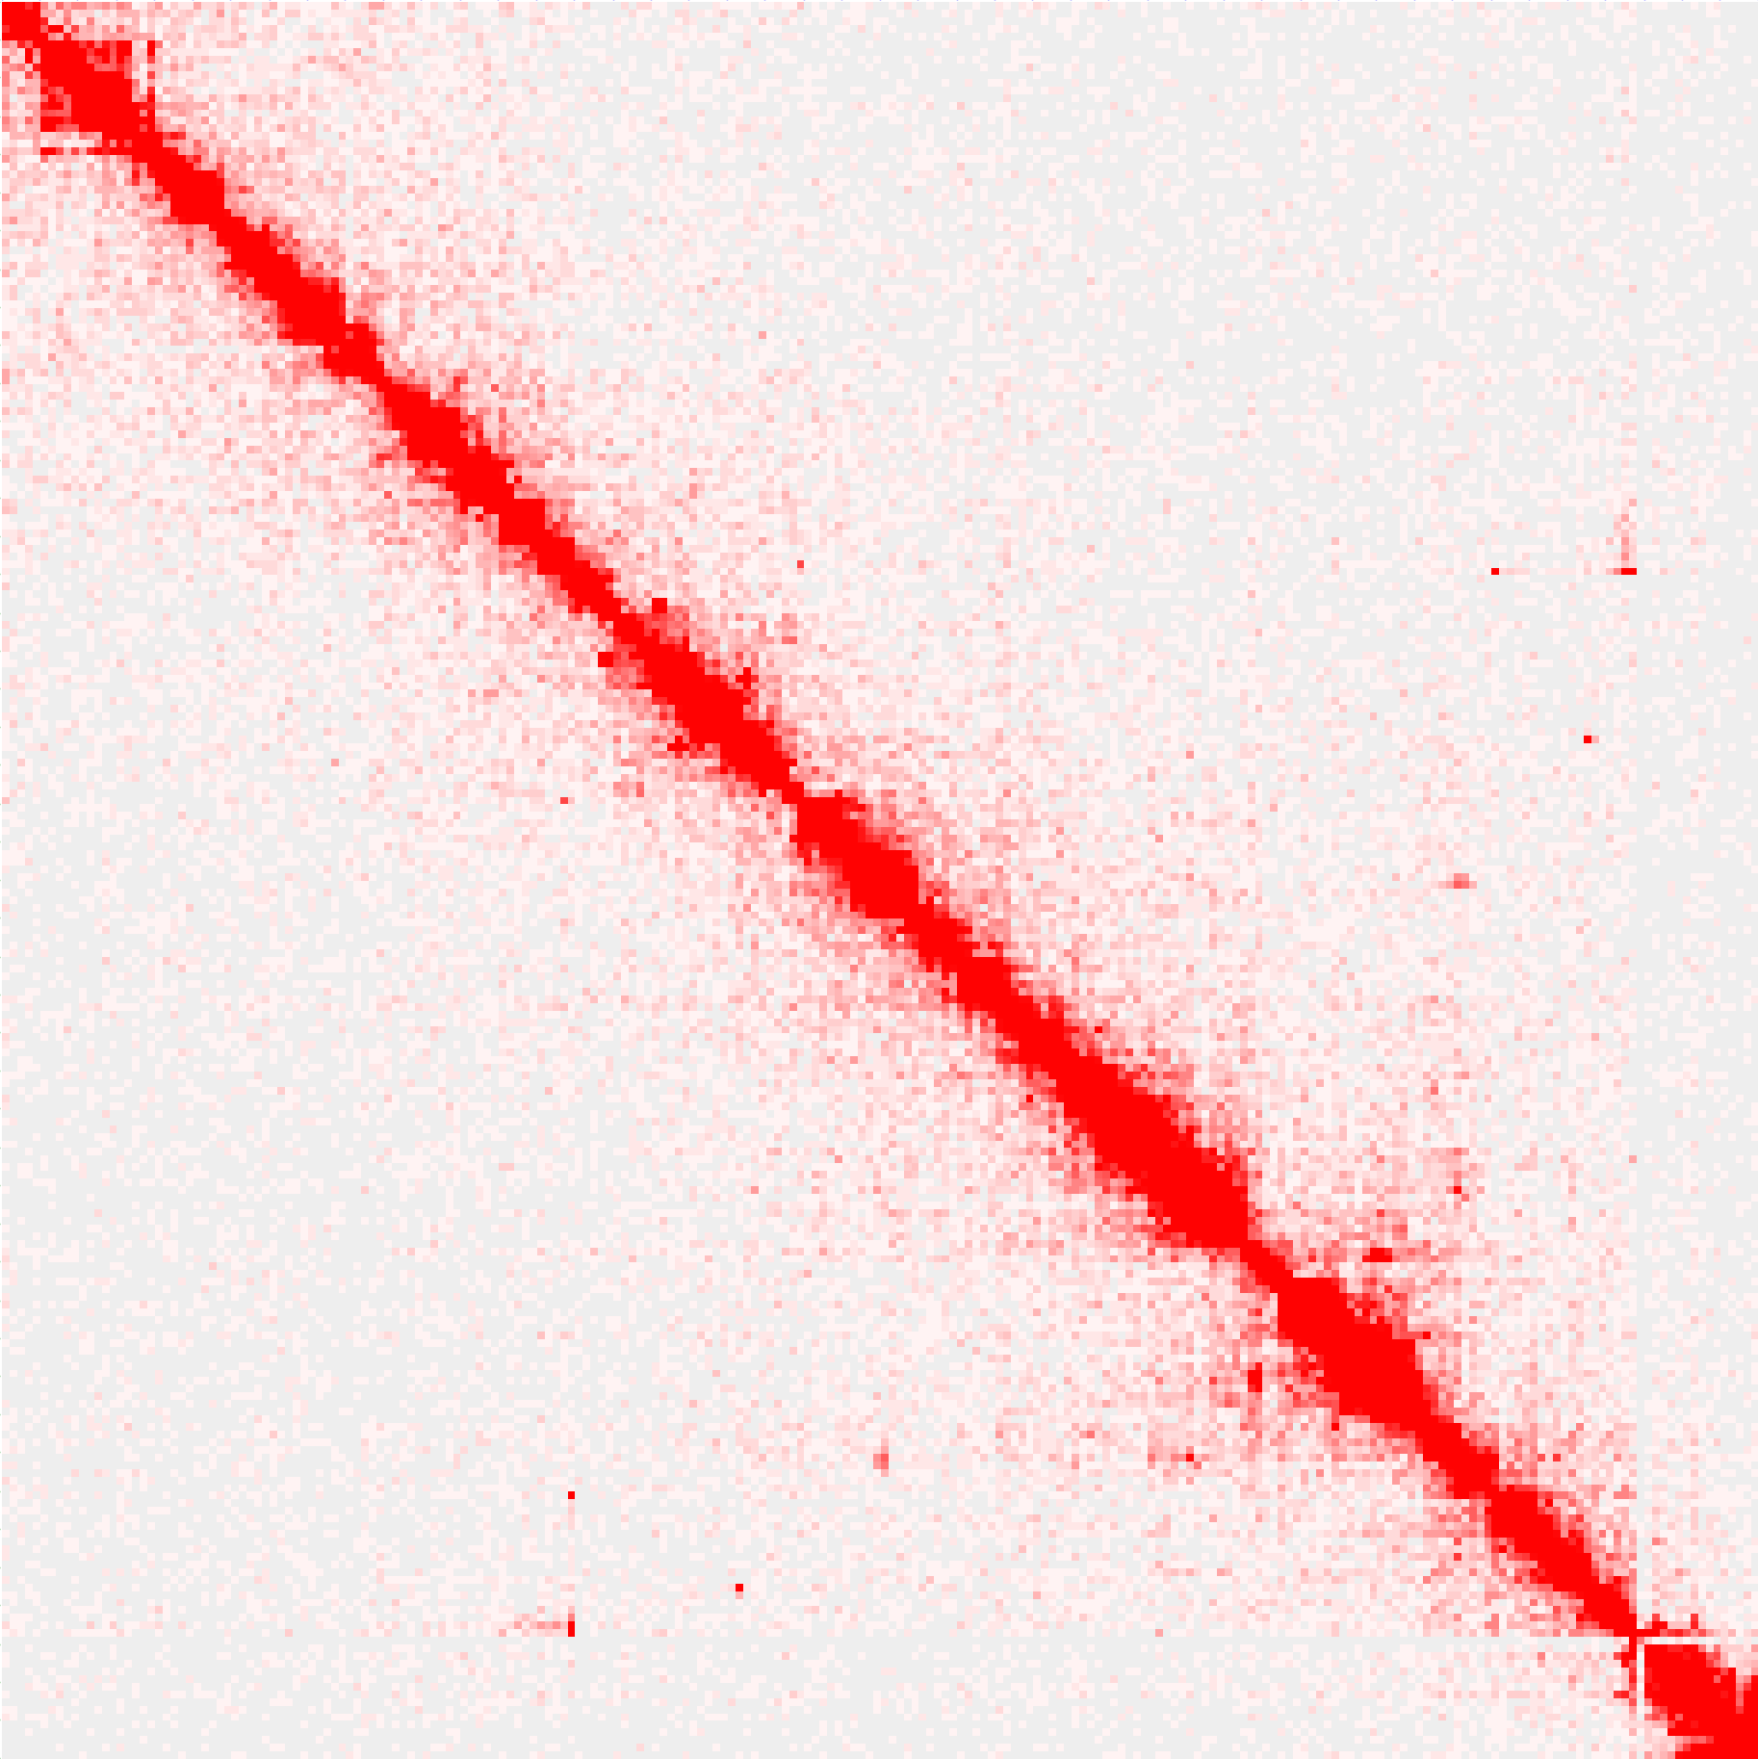
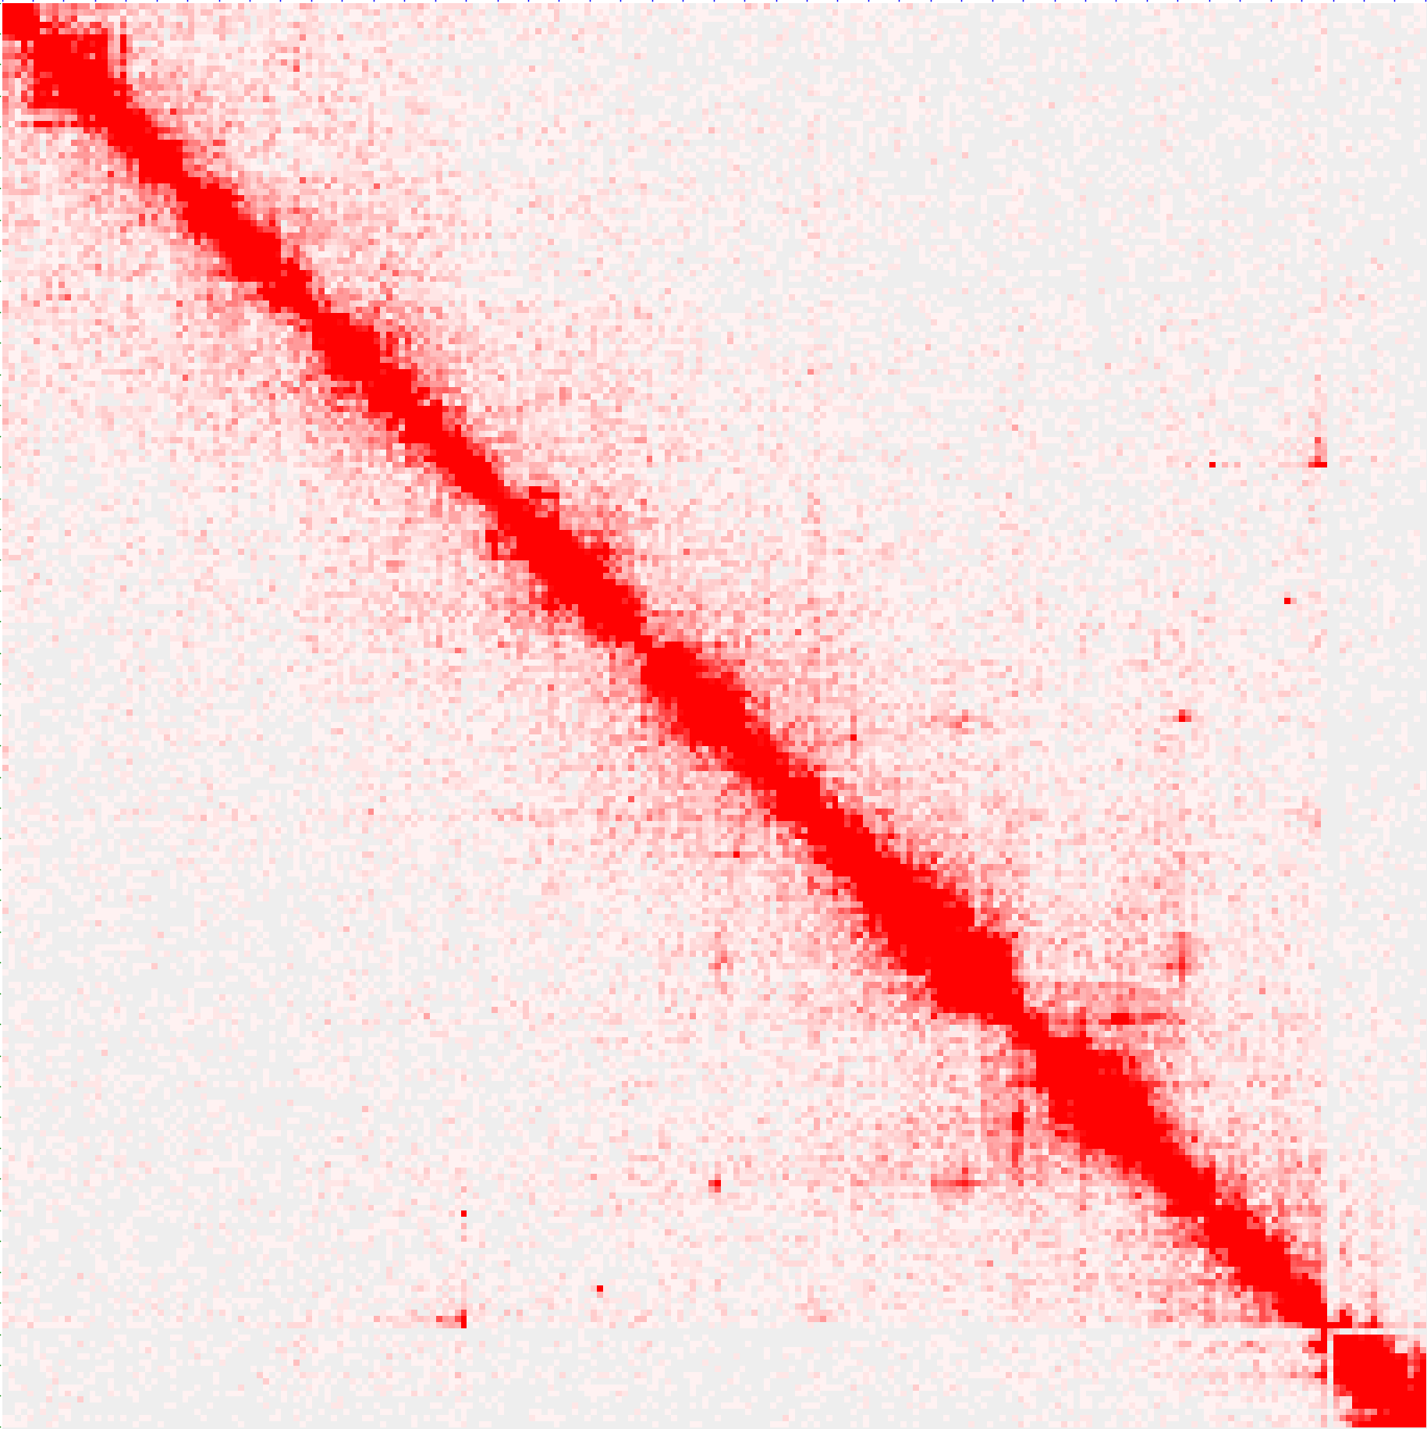
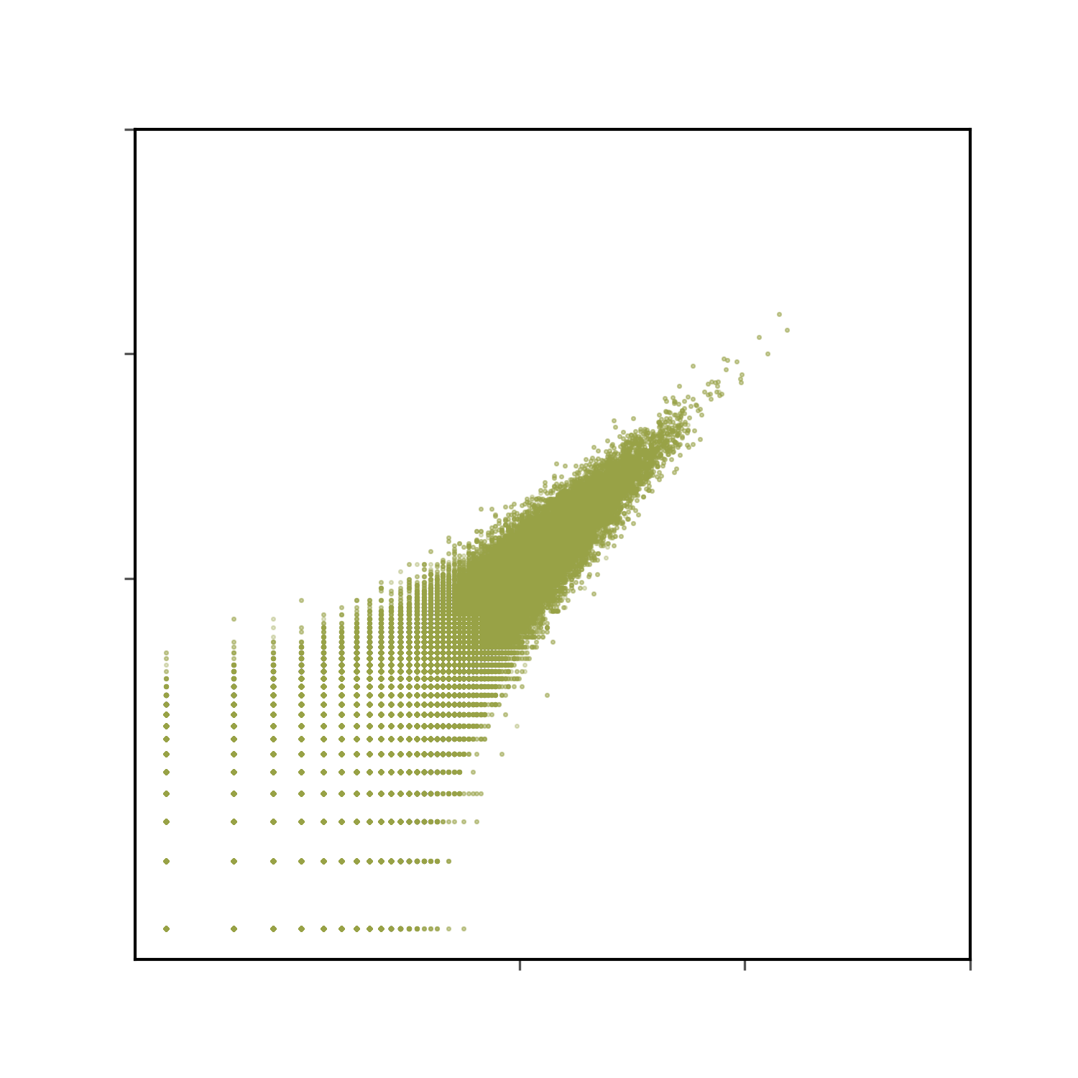

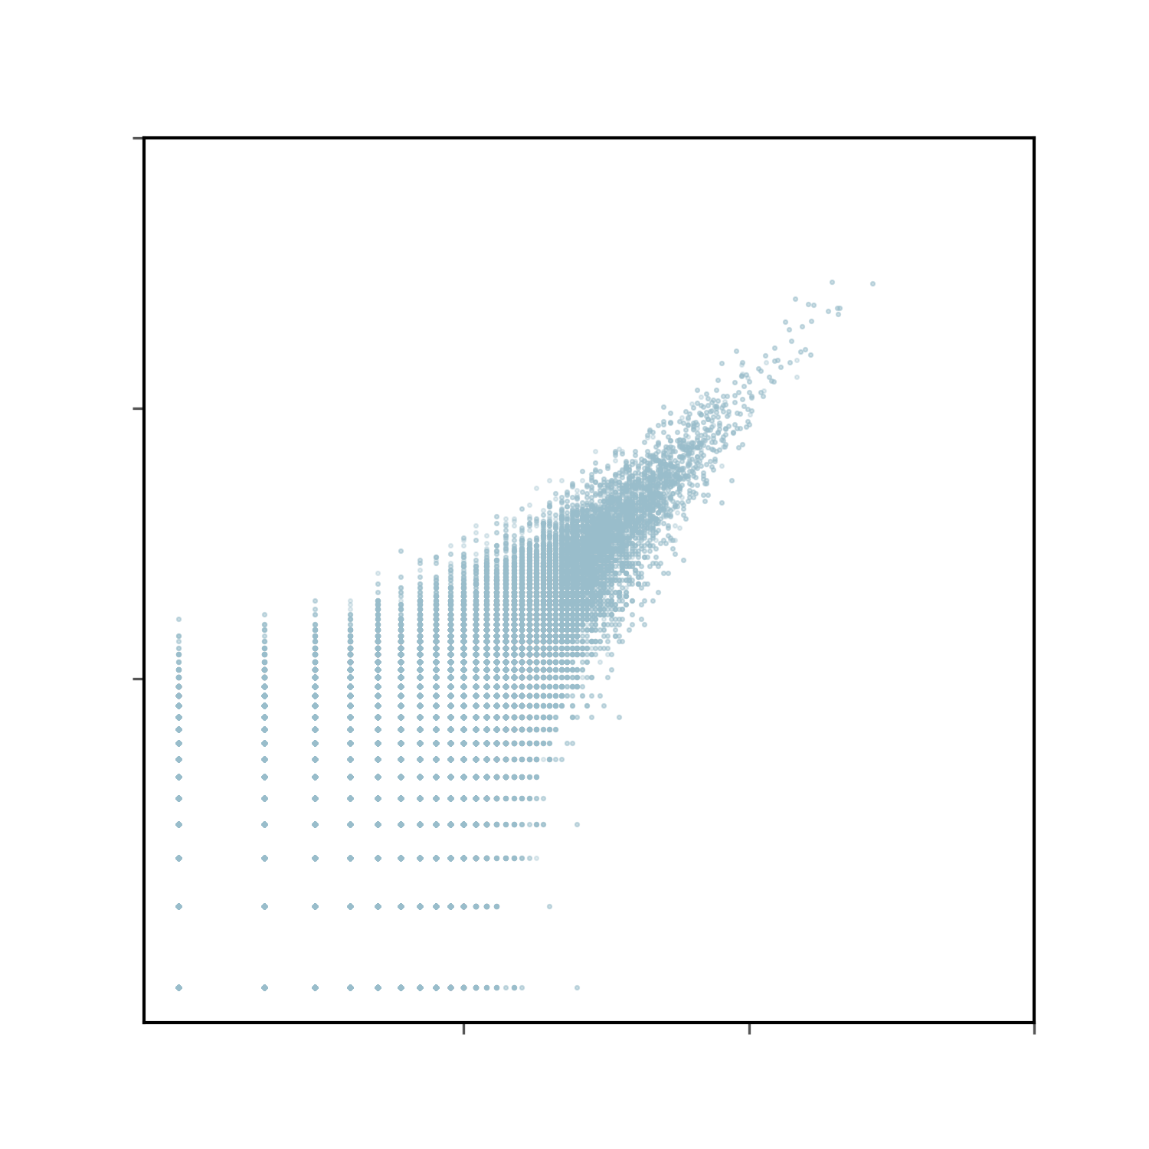
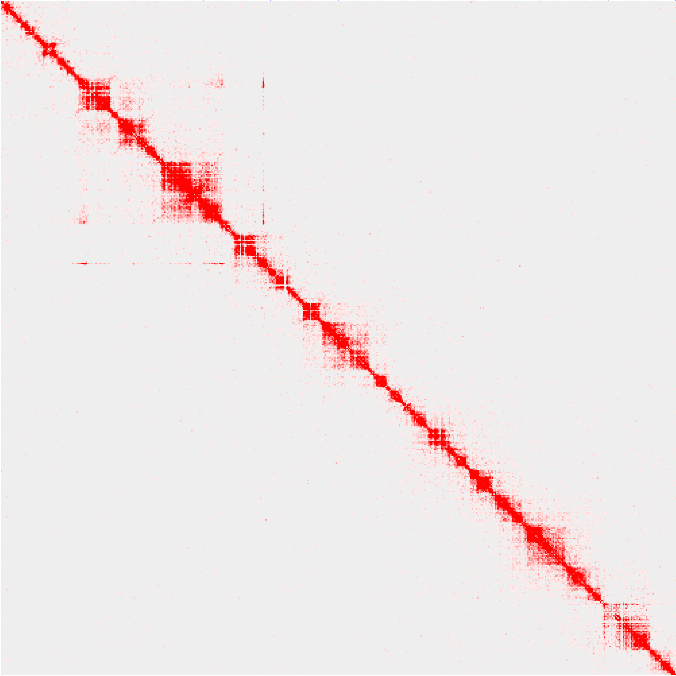
Data quality
Data reproducibility of in situ ChIA-PET (hic matrix)
H3K27me3_WT_rep1 chr2L
H3K27me3_WT_rep2 chr2L
Pearson’s
R = 0.97
100Kb
100Kb
Pearson’s
R = 0.99
Pearson’s
R = 0.95
10 100 1000
10 100 1000
10 100 1000
H3K27me3_WT_rep2
H3K27ac_WT_rep2
RNAPII_WT_rep2
10 100 1000
10 100 1000
10 100 1000
H3K27me3_WT_rep1
H3K27ac_WT_rep1
RNAPII_WT_rep1
chr2L: 0-5 Mb
chr2L: 0-5 Mb
Pearson’s
R = 0.96
10Kb
10Kb
Pearson’s
R = 0.99
Pearson’s
R = 0.91
10 100 1000
10 100 1000
10 100 1000
H3K27me3_HS_rep2
H3K27ac_HS_rep2
RNAPII_HS_rep2
10 100 1000
10 100 1000
10 100 1000
H3K27me3_HS_rep1
H3K27ac_HS_rep1
RNAPII_HS_rep1

Slide 10
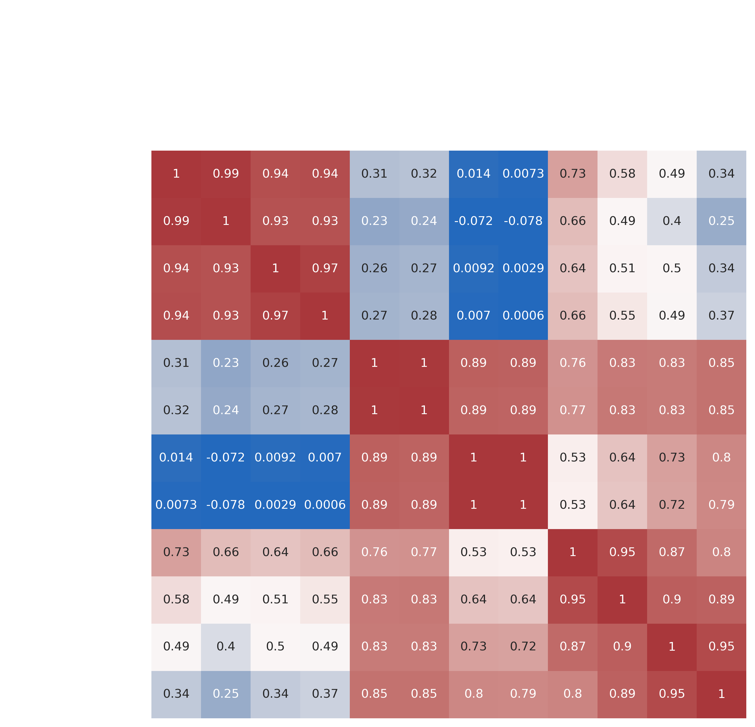
Data quality
Data reproducibility of in situ ChIA-PET (hic matrix)
H3K27ac_WT_rep2
H3K27ac_HS_rep1
H3K27ac_WT_rep1
H3K27ac_HS_rep2
H3K27me3_HS_rep2
H3K27me3_HS_rep1
RNAP II_WT_rep2
RNAP II_HS_rep2
H3K27me3_WT_rep2
RNAP II_HS_rep1
H3K27me3_WT_rep1
RNAP II_WT_rep1
H3K27me3_WT_rep1
H3K27me3_WT_rep2
H3K27me3_HS_rep1
The SCC between the WT and its corresponding HS is smaller than that of two replicates;
The SCC between H3K27ac and RNAPII is larger than that between H3K27me3 and RNAPII.
H3K27me3_HS_rep2
H3K27ac_WT_rep1
H3K27ac_WT_rep2
H3K27ac_HS_rep1
H3K27ac_HS_rep2
RNAP II_WT_rep1
RNAP II_WT_rep2
RNAP II_HS_rep1
RNAP II_HS_rep2
Heatmap of stratum adjusted correlation coefficient (SCC)
(SCC is called using HiCRep.)
Yang et al., Genome Res. 2017

Slide 11
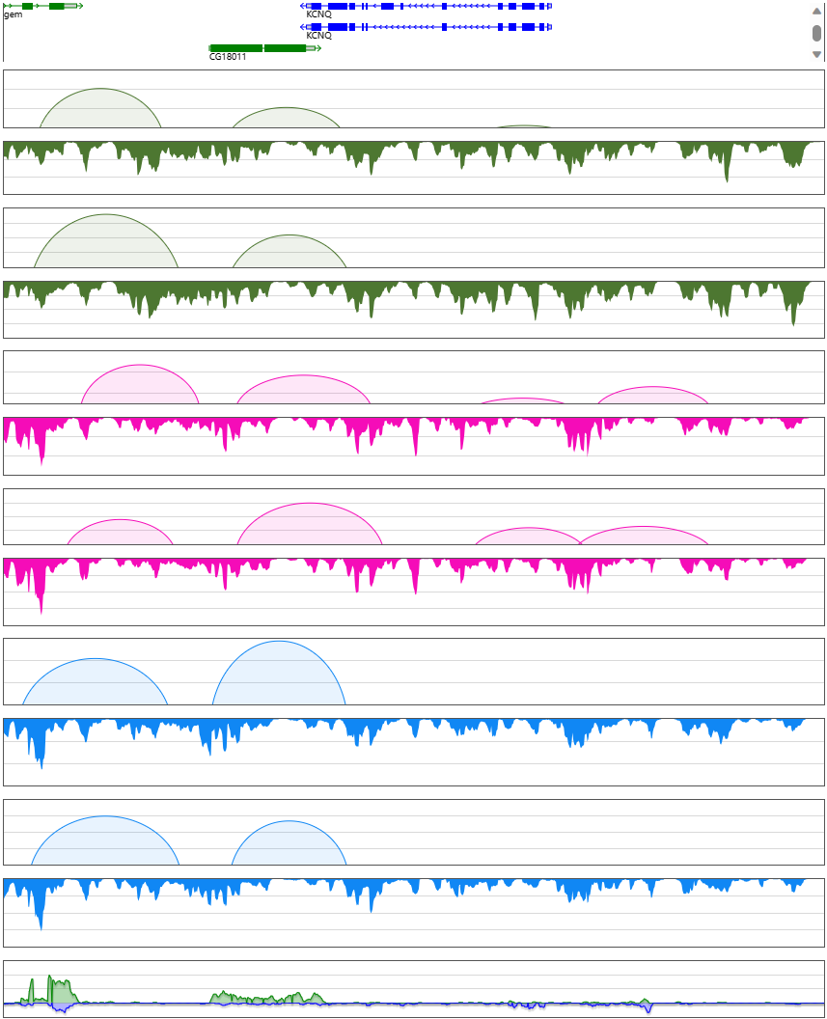
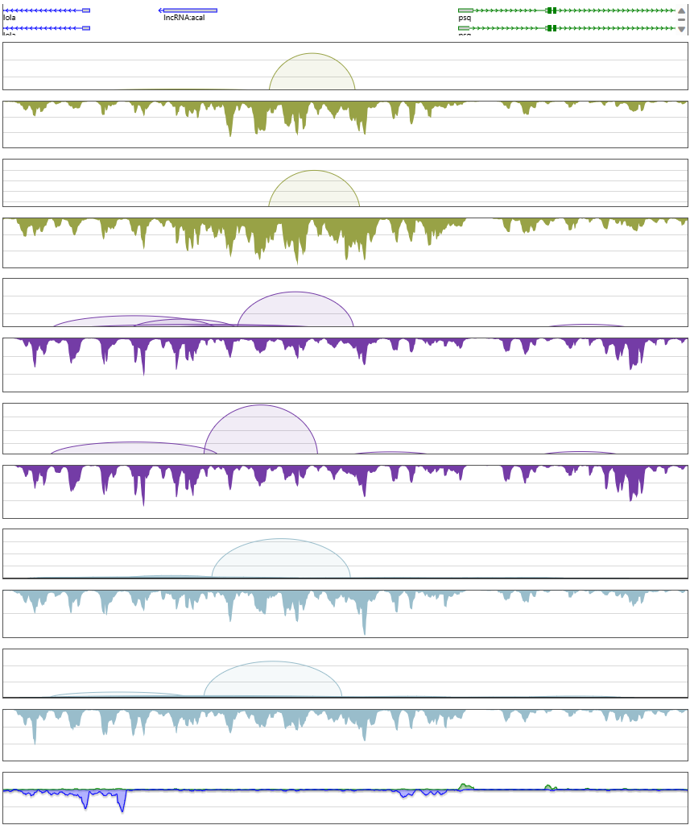
Data quality
Data reproducibility of in situ ChIA-PET (loops and coverage)
chr2R:6022306-6052385 (30Kb)
chr2R:6425378-6455457 (30Kb)
Genes
Genes
loop
loop
rep1
rep1
H3K27me3_WT
coverage
H3K27me3_HS
coverage
loop
loop
rep2
rep2
coverage
coverage
loop
loop
rep1
rep1
coverage
coverage
H3K27ac_WT
loop
H3K27ac_HS
loop
rep2
coverage
rep2
coverage
loop
loop
rep1
rep1
coverage
RNAPII_HS
coverage
RNAPII_WT
loop
loop
rep2
rep2
coverage
coverage
RNA-seq
RNA-seq

Slide 12
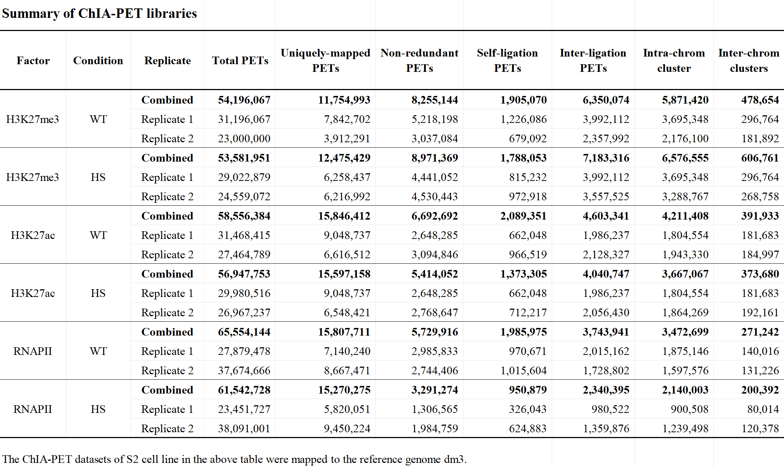
Data quality
Combine two replicates of ChIA-PET libraries for further analysis
WT and its corresponding HS have similar number of uniquely-mapped PETs
CDS001D21C_downsmaple
CDS002D13C
CDS004D10DC
CDS005D11DC
CDS007D15C
CDS008D16C
in situ ChIA-PET: Duo Ning, Yang Yang
ChIA-PIPE: Deng Yuqing
RNA-seq: Novogen

Slide 13
Data analysis
Describe features before and after heat shock at different scales (Compartments, TADs, Loops)
Explore the relationship between features and gene expression

Slide 14
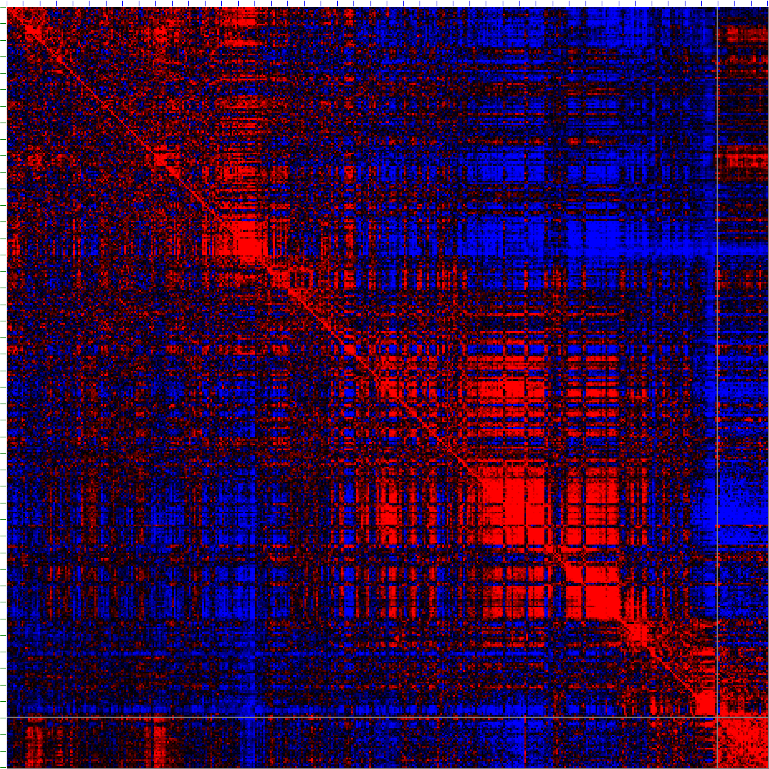
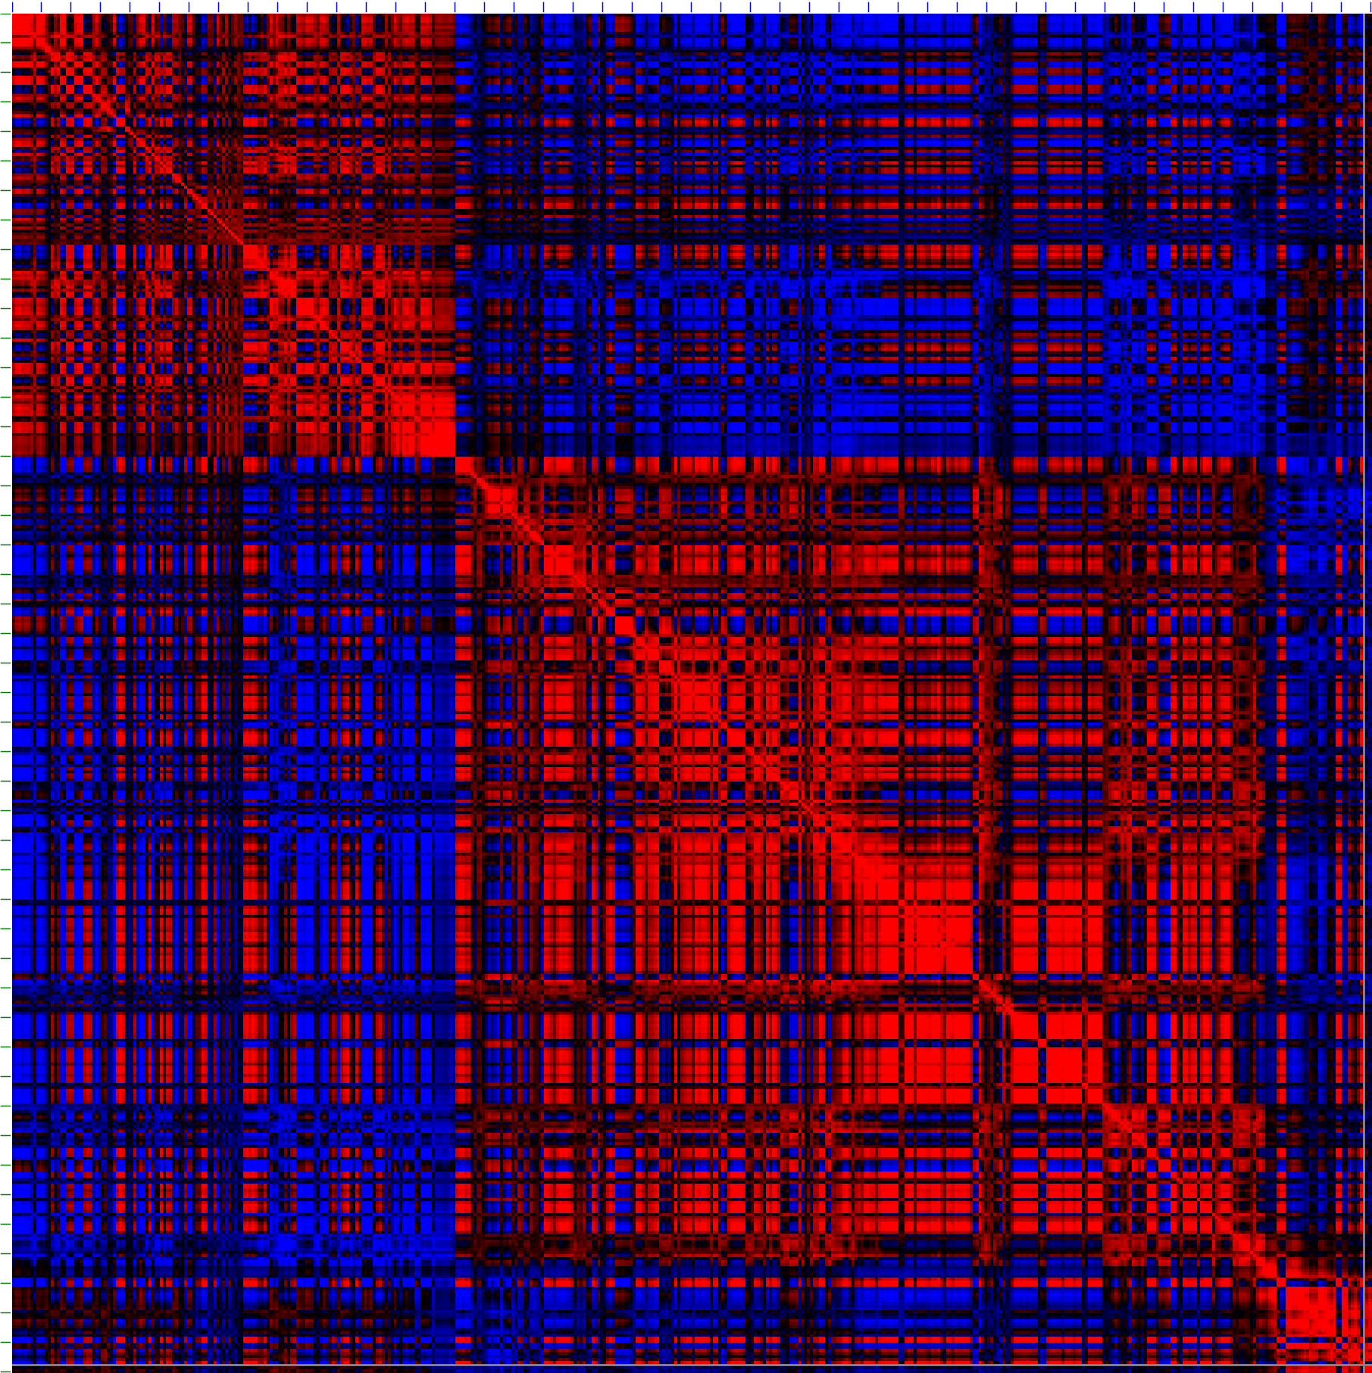
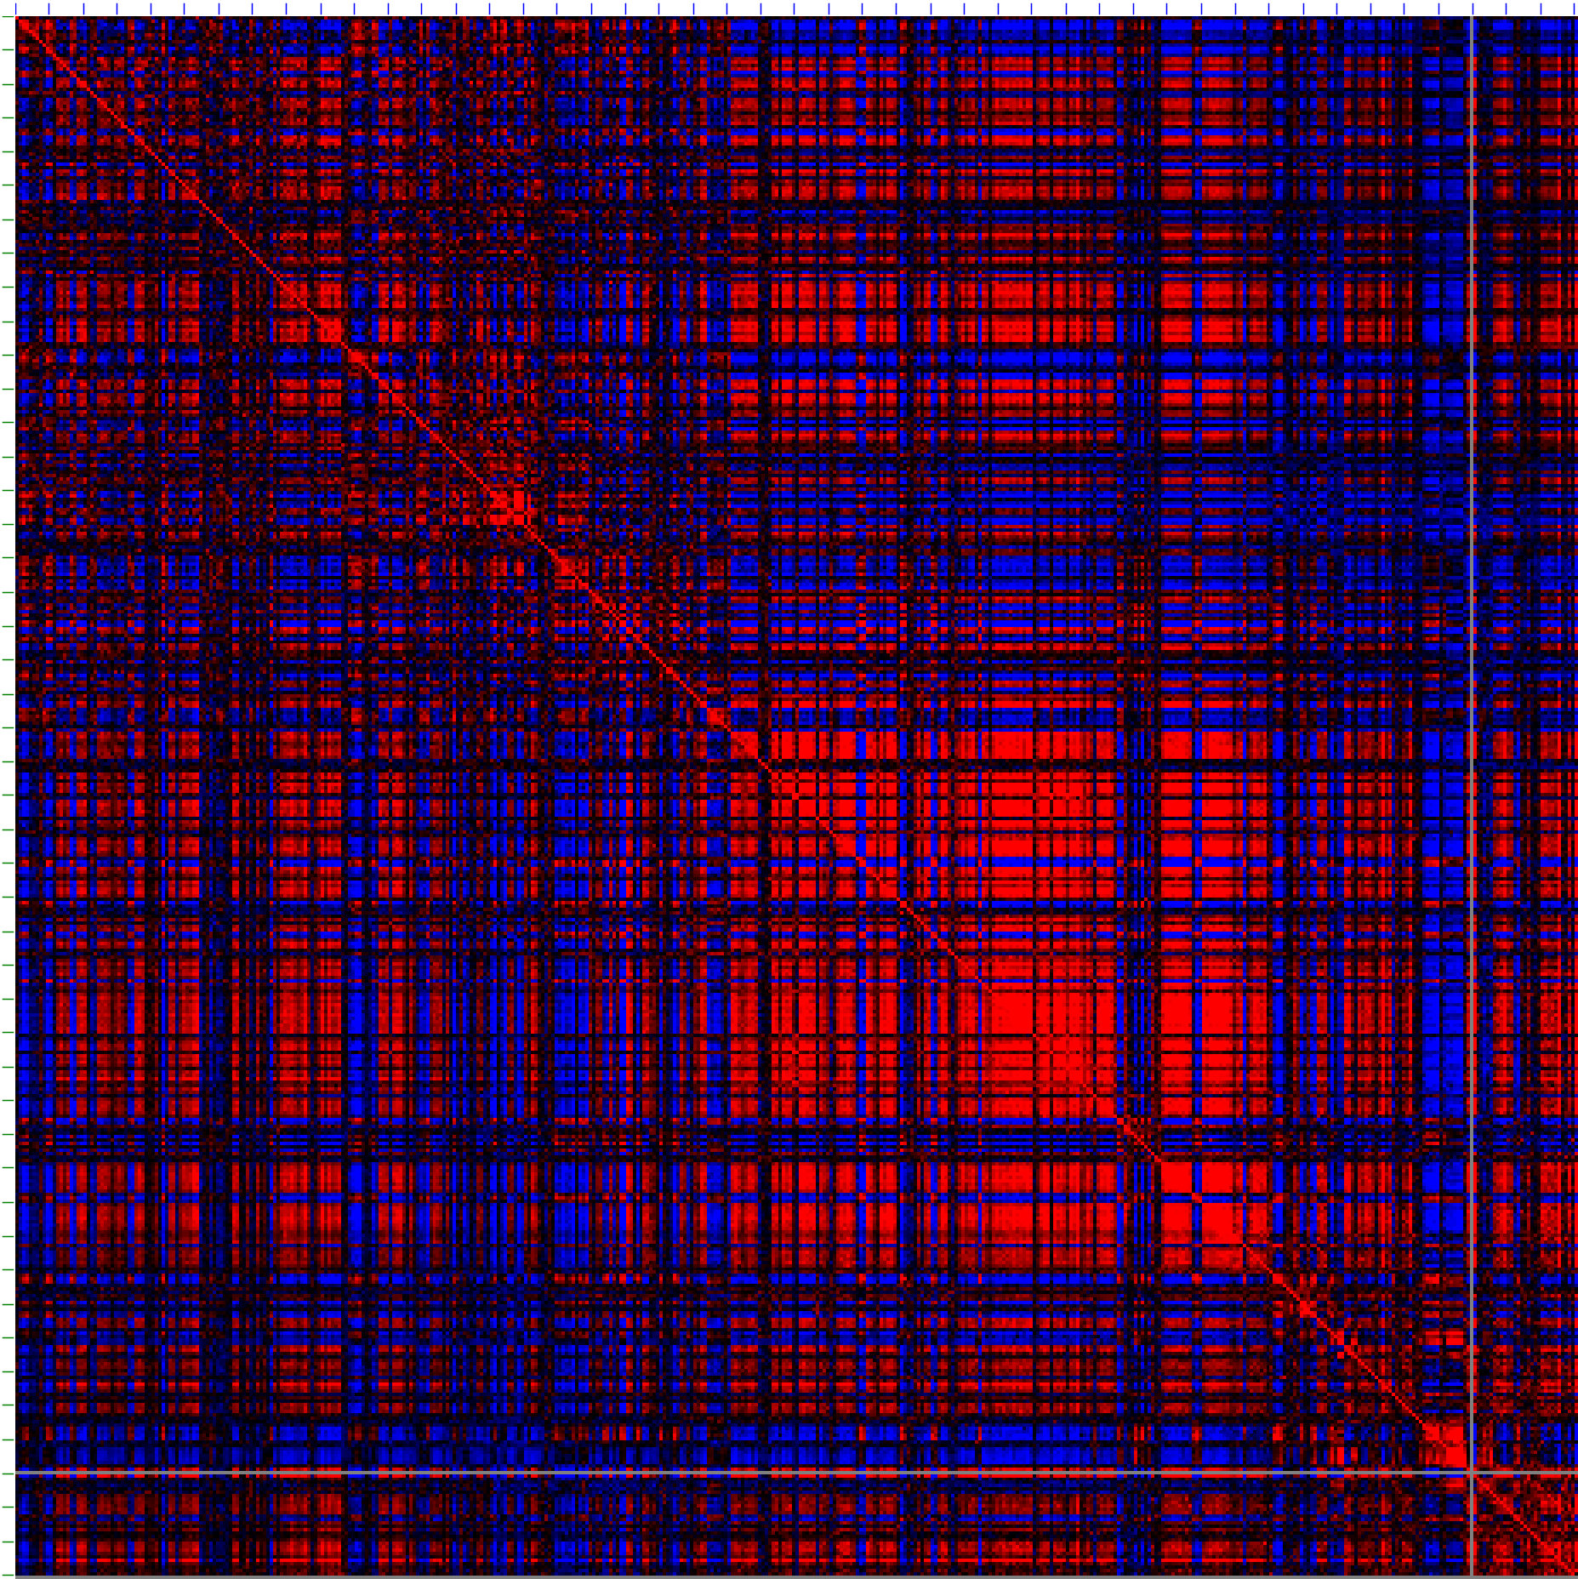
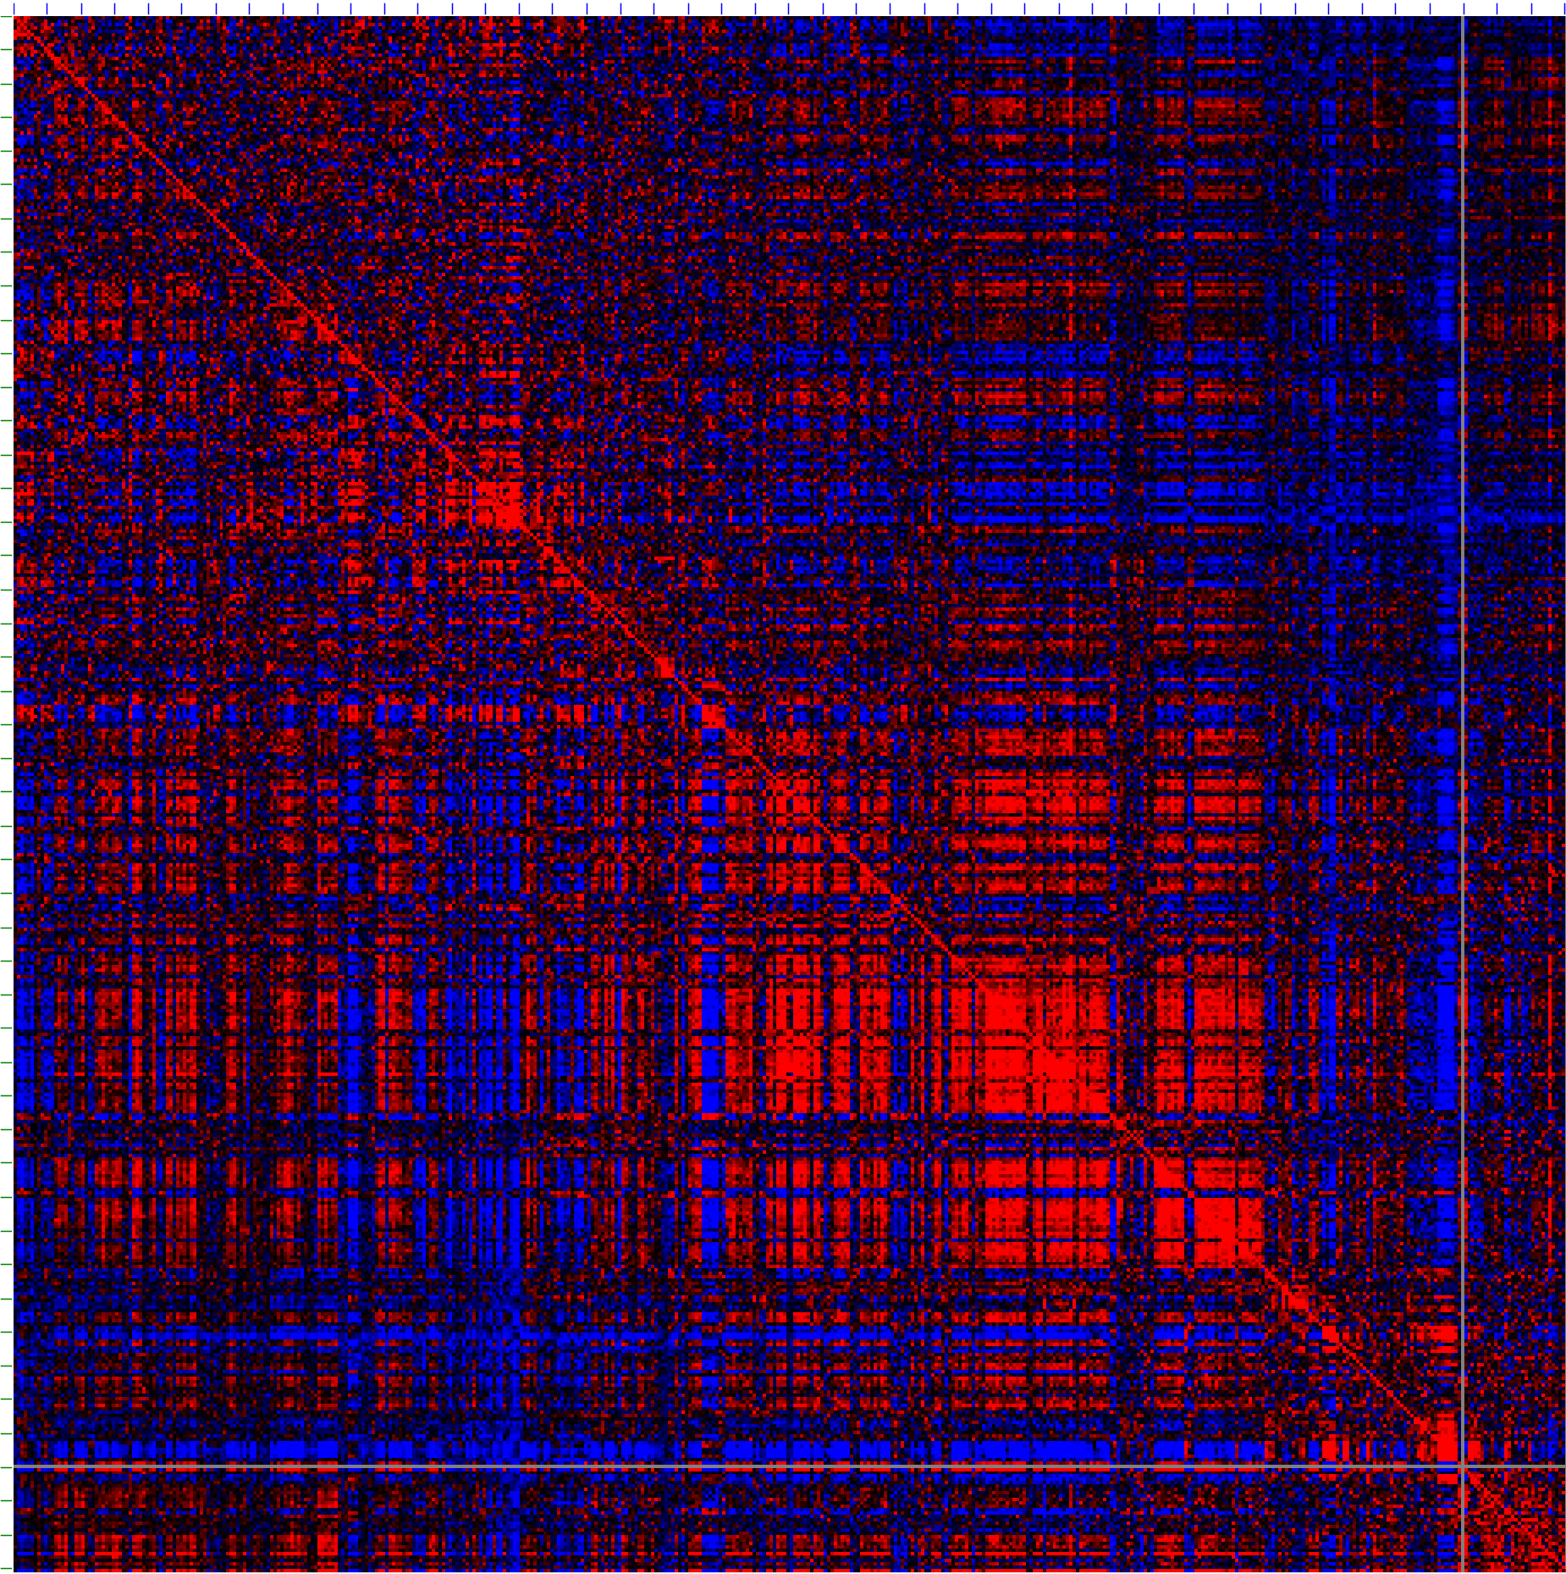
Compartment level
Different factors enrich different compartment patterns
0 5 10 15 20 Mb (2L)
0 5 10 15 20 Mb (2L)
H3K27me3_HS
Hi-C_HS
20 15 10 5 0
20 15 10 5 0
1. Compartment patterns enriched by H3K27me3 (block-like) and H3K27ac (stripe-like) are different.
2. Compartments of H3K27me3 are more similar to that of Hi-C (data from PNAS paper), while those of H3K27ac are more similar to those of RNAPII.
H3K27me3_WT
Hi-C_WT
0 5 10 15 20 Mb (2L)
0 5 10 15 20 Mb (2L)
(ChIA-PET has around 20% enrichment, so the contact matrix is the mix of the Hi-C and the factor)
H3K27ac_HS
RNAP II_HS
Ray et al., PNAS. 2019
20 15 10 5 0
20 15 10 5 0
Pearson’s correlation matrix at 50Kb resolution is called by Juicebox.
Robinson et al., Cell Systems. 2018
H3K27ac_WT
RNAP II_WT

Slide 15
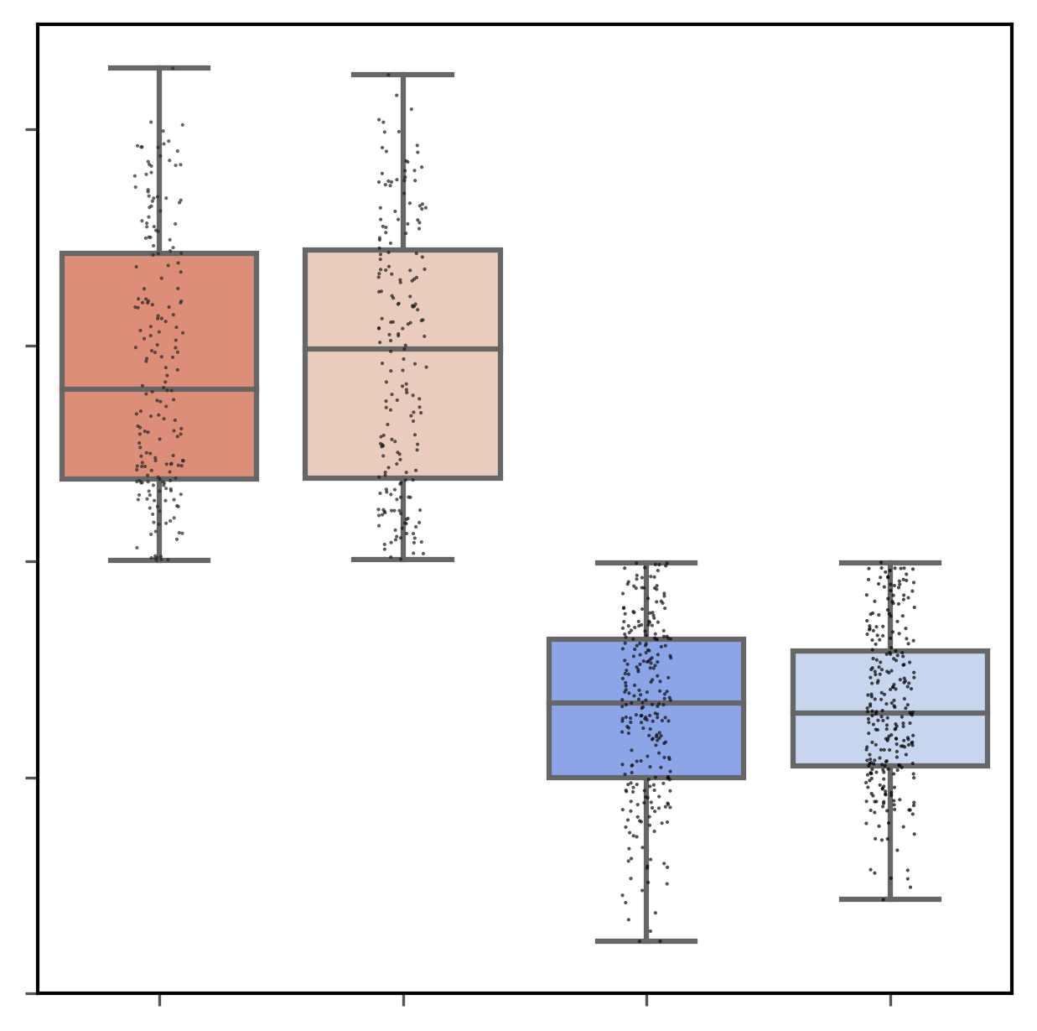
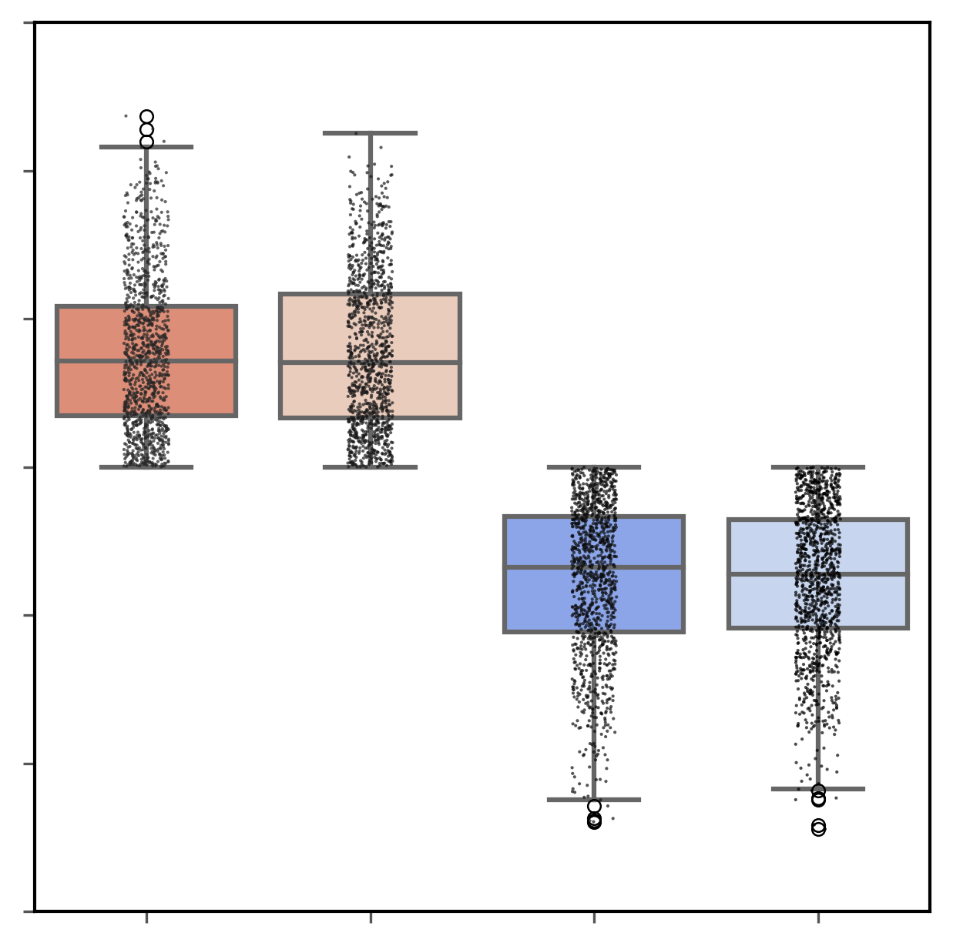
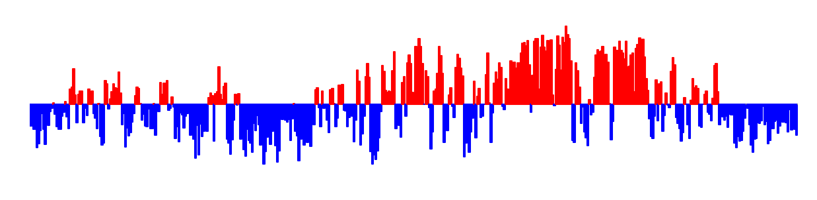
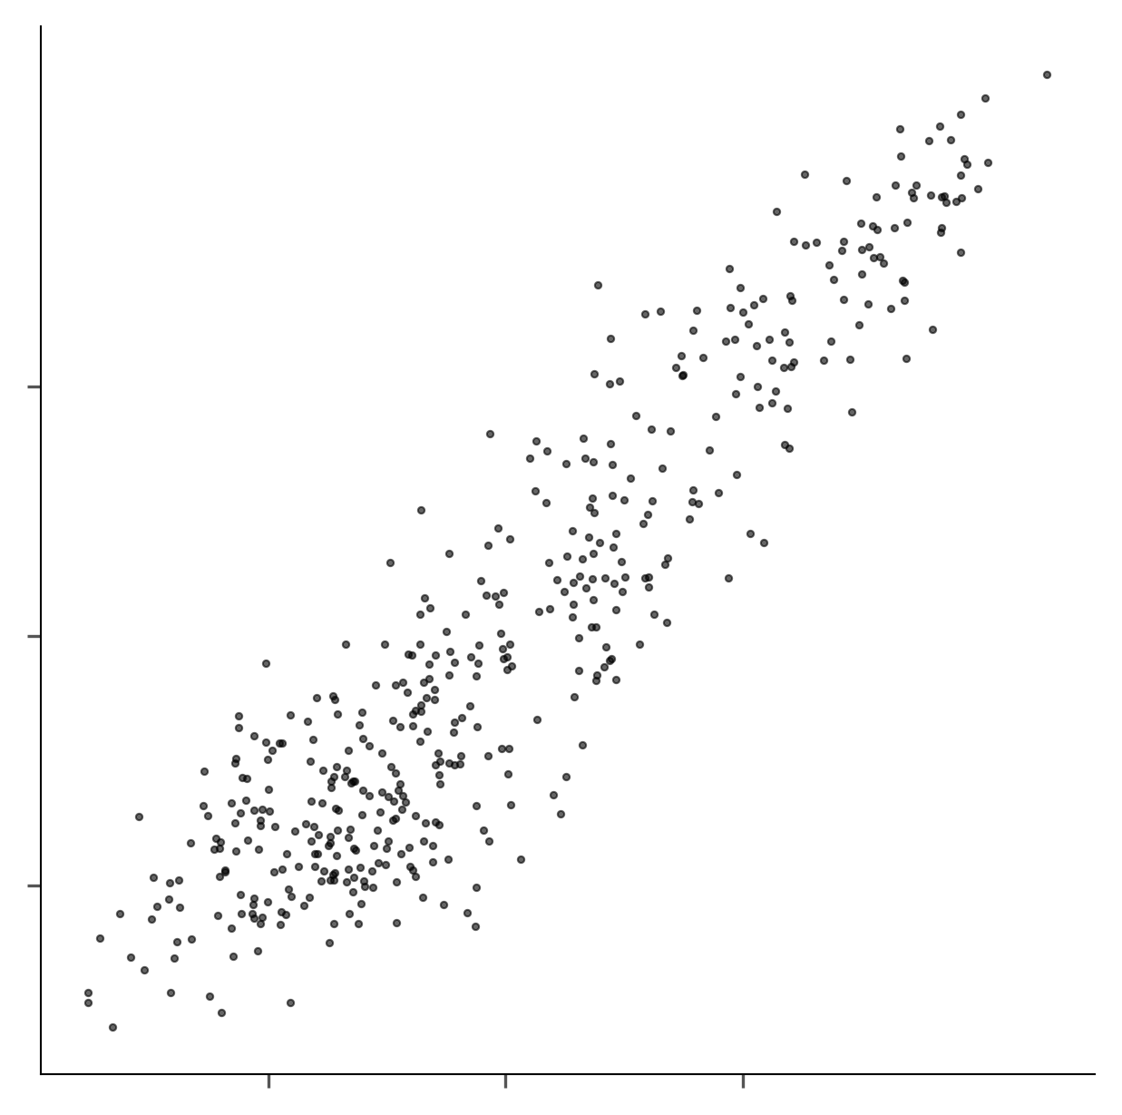
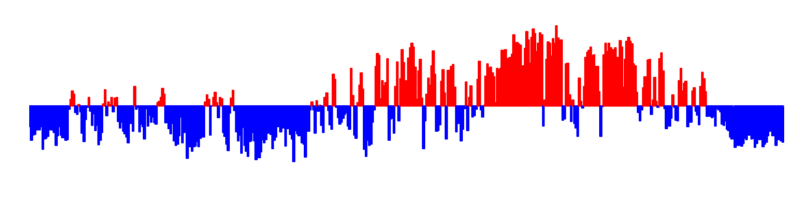
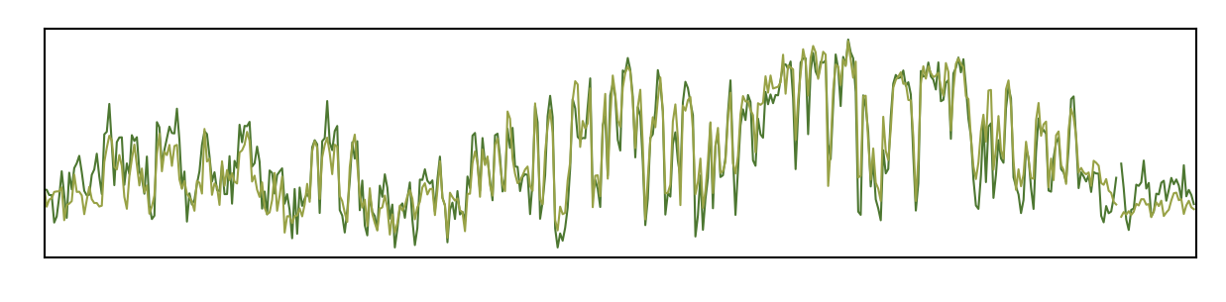
Compartment level
Compartments have no significant changes after heat shock
0 5 10 15 20 Mb (2L)
p=0.45
p=0.70
H3K27me3_HS
Compartment strength
Compartment strength
p=0.84
-0.1 -0.05 0 0.05 0.1
p=0.79
20 15 10 5 0
-0.1 -0.05 0 0.05 0.1
WT_A HS_A WT_B HS_B
WT_A HS_A WT_B HS_B
H3K27me3_WT
H3K27me3 (chr2L)
H3K27me3 (all chroms)
Compartment strength
The compartment patterns before and after heat shock are quite similar;
[-0.1 - 0.1]
A
B
WT
Spearman’s R = 0.92
Compartments
K-S test p = 0.67
[-0.1 - 0.1]
A
B
HS
Compartment strength before and after heat shock has a high correlation score, large K-S test p value, and shows no significant difference (Mann-Whitney U test).
H3K27me3_HS (chr2L)
0 5 10 15 20 Mb (2L)
-0.05 0 0.05
Compartment strength
H3K27me3_WT
H3K27me3_HS
A/B compartments at 50Kb resolution is
called by Juicebox.
Robinson et al., Cell Systems. 2018
-0.05 0 0.05
H3K27me3_WT (chr2L)
Notes:
ttest_ind: The test assumes that the populations from which the samples are drawn are normally distributed and have equal variances (homoscedasticity). If these assumptions are not met, the results of the test might be unreliable. There's an argument in the function, equal_var, which can be set to False to perform the test under the assumption of unequal variances (Welch's t-test). For very non-normal distributions or for certain types of data, other non-parametric tests (like the Mann-Whitney U test) might be more appropriate.

Slide 16
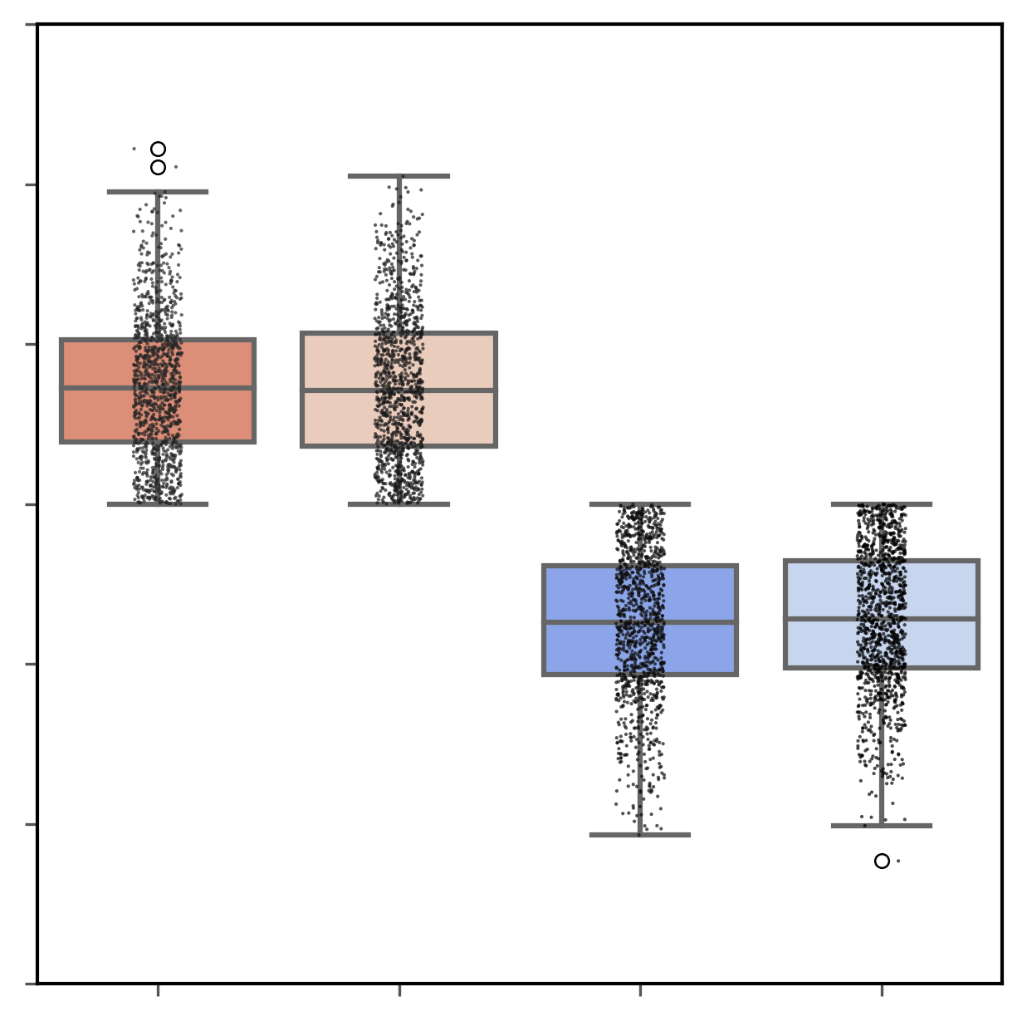
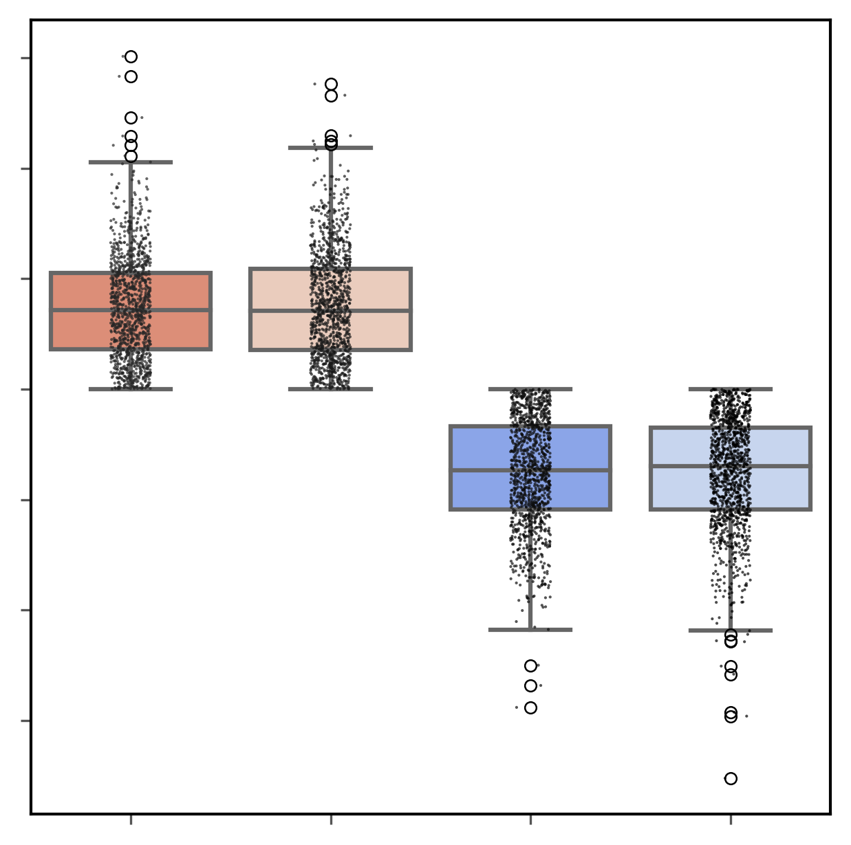
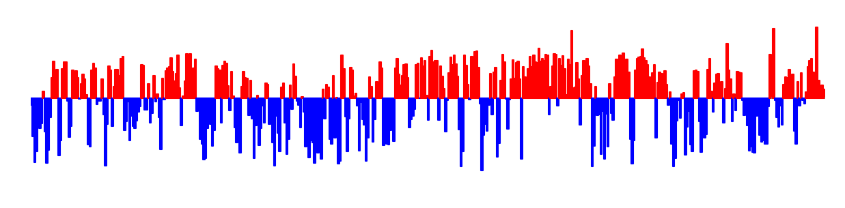
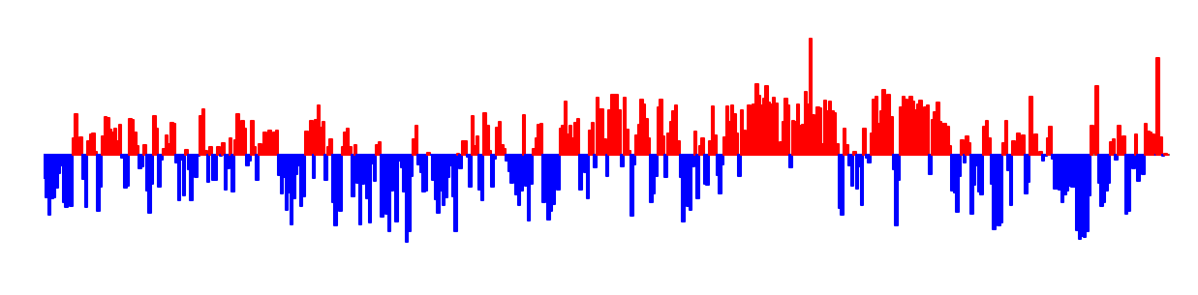
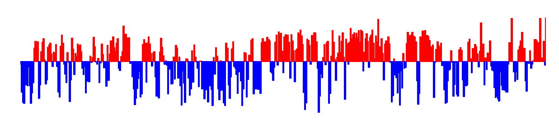
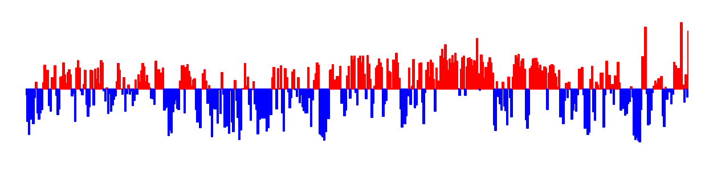
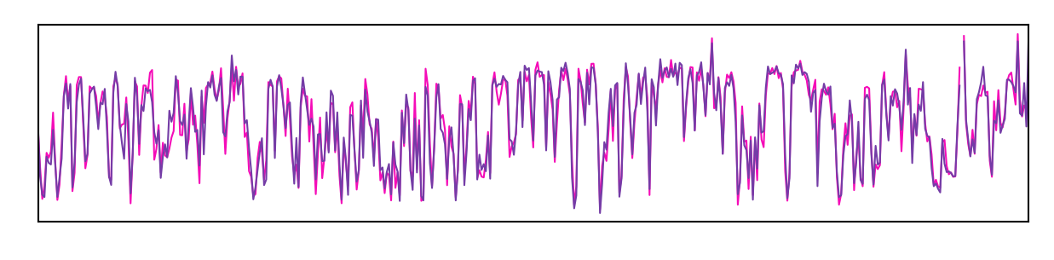
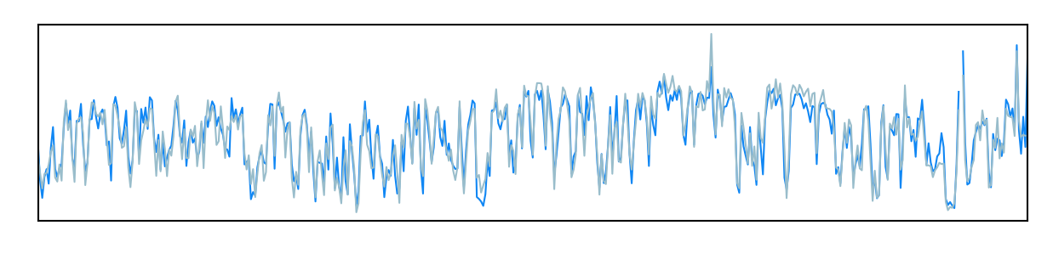
Compartment level
Compartments have no significant changes after heat shock
0 5 10 15 20 Mb (2L)
0 5 10 15 20 Mb (2L)
p=0.72
p=0.26
H3K27ac_HS
RNAPII_HS
Compartment strength
-0.1 -0.05 0 0.05 0.1
p=0.51
Compartment strength
-0.1 -0.05 0 0.05 0.1
p=0.09
20 15 10 5 0
20 15 10 5 0
WT_A HS_A WT_B HS_B
WT_A HS_A WT_B HS_B
H3K27ac_WT
RNAPII_WT
H3K27ac (all chroms)
RNAP II (all chroms)
[-0.1 - 0.1]
[-0.1 - 0.1]
K-S test between WT and its corresponding HS
A
B
WT
P value | H3K27me3 | H3K27ac | RNAP II
chr2L | 0.67 | 0.91 | 0.41
chr2R | 0.99 | 1 | 0.92
chr3L | 0.25 | 0.76 | 0.93
chr3R | 0.90 | 0.93 | 0.99
chrX | 0.60 | 1 | 0.71
[-0.1 - 0.1]
[-0.1 - 0.1]
Compartments
A
B
HS
0 5 10 15 20 Mb (2L)
0 5 10 15 20 Mb (2L)
Compartment strength
H3K27ac_WT
Compartment strength
RNAP II_WT
H3K27ac_HS
RNAP II_HS

Slide 17
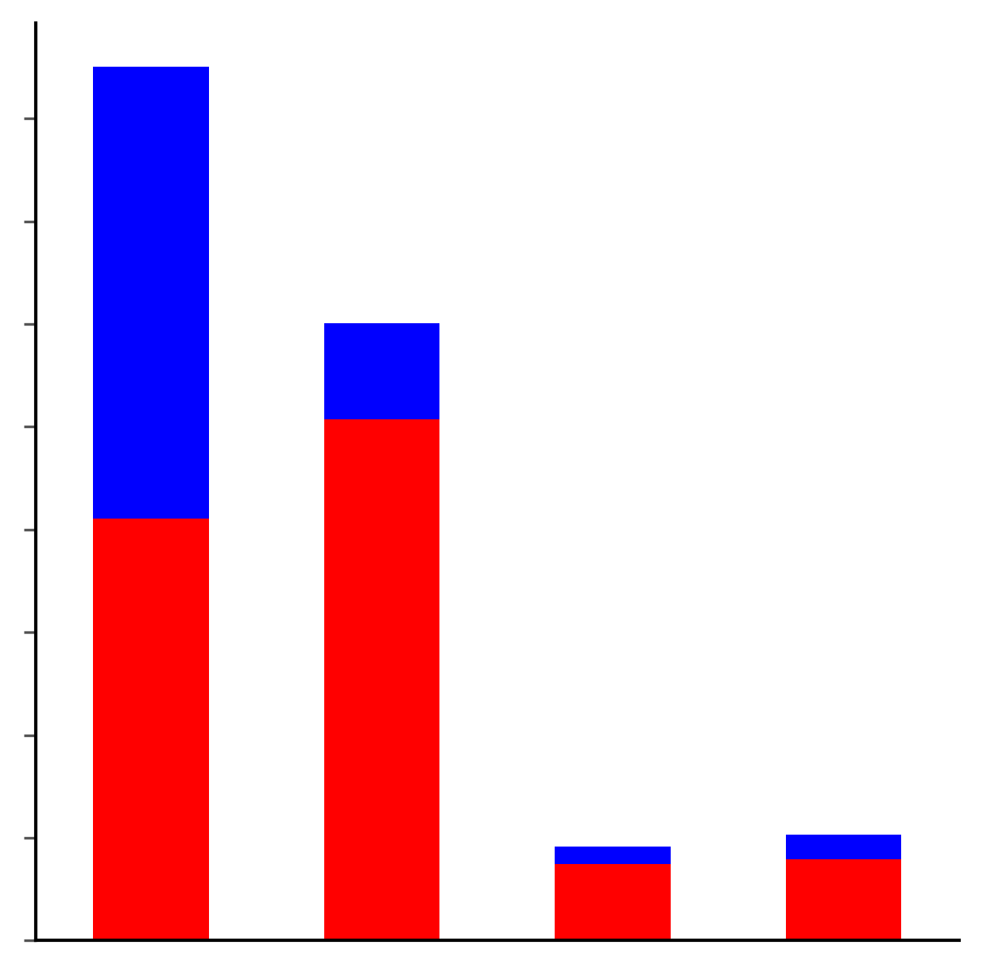
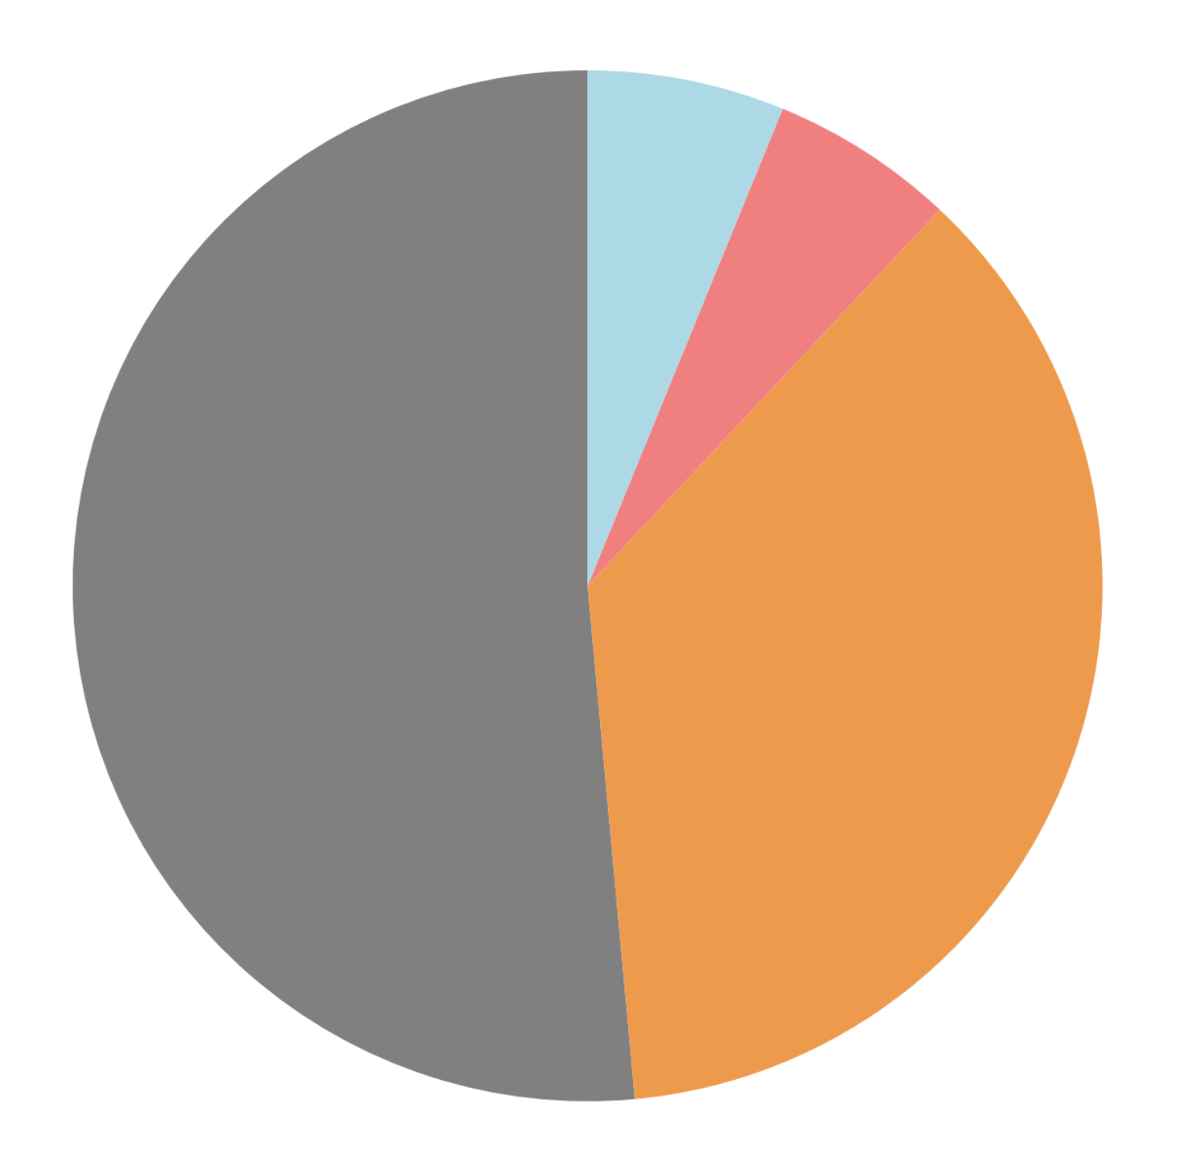
Compartment level and gene expression
Most unregulated genes and DEGs are located in A compartments
988
8000
B
1,054
unexpressed
A
unregulated
up-regulated
7000
down-regulated
6000
Number of genes
5000
8,769
4000
6,228
3000
2000
1000
0
Unexpressed
Unregulated
Up-regulated
Down-regulated
Number of genes in different categories
While there are no significant changes in A/B compartments after heat shock, thousands of DEGs and most unregulated genes are also located in A compartments.

Slide 18
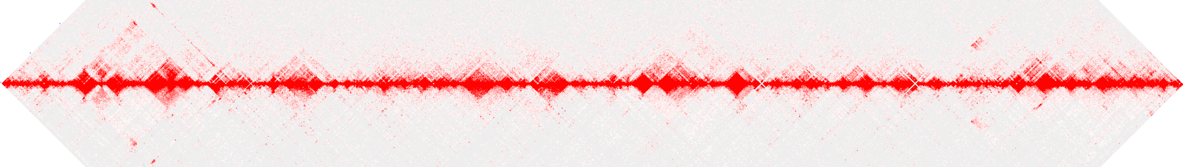
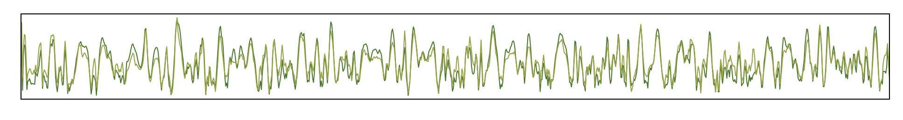
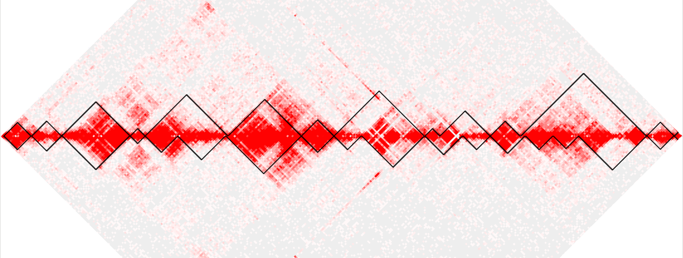
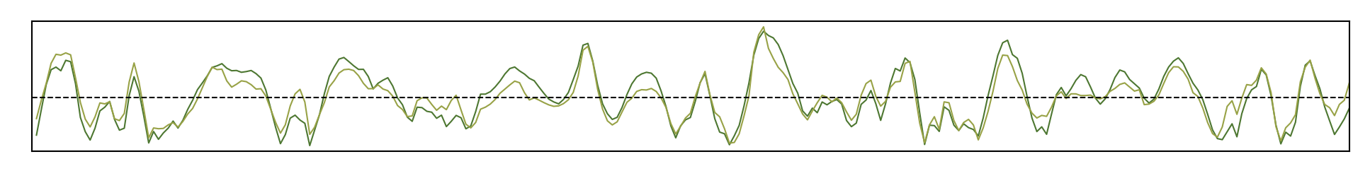
TAD level
TAD enriched by H3K27me3 before and after HS
A
Chr2L: 0-10Mb
H3K27me3_HS
H3K27me3_WT
TAD score
B
Chr2L: 0.3-3Mb
Some TADs merge after heat shock;
The local minimal of TAD score (TAD separation score) increases after heat shock, indicating that the TAD boundaries weaken after heat shock.
H3K27me3_HS
H3K27me3_WT
TADs at 10Kb resolution is called by hicexplorer
Ramirez et al., Nature Communications. 2018
TAD score
H3K27me3_WT
H3K27me3_HS

Slide 19
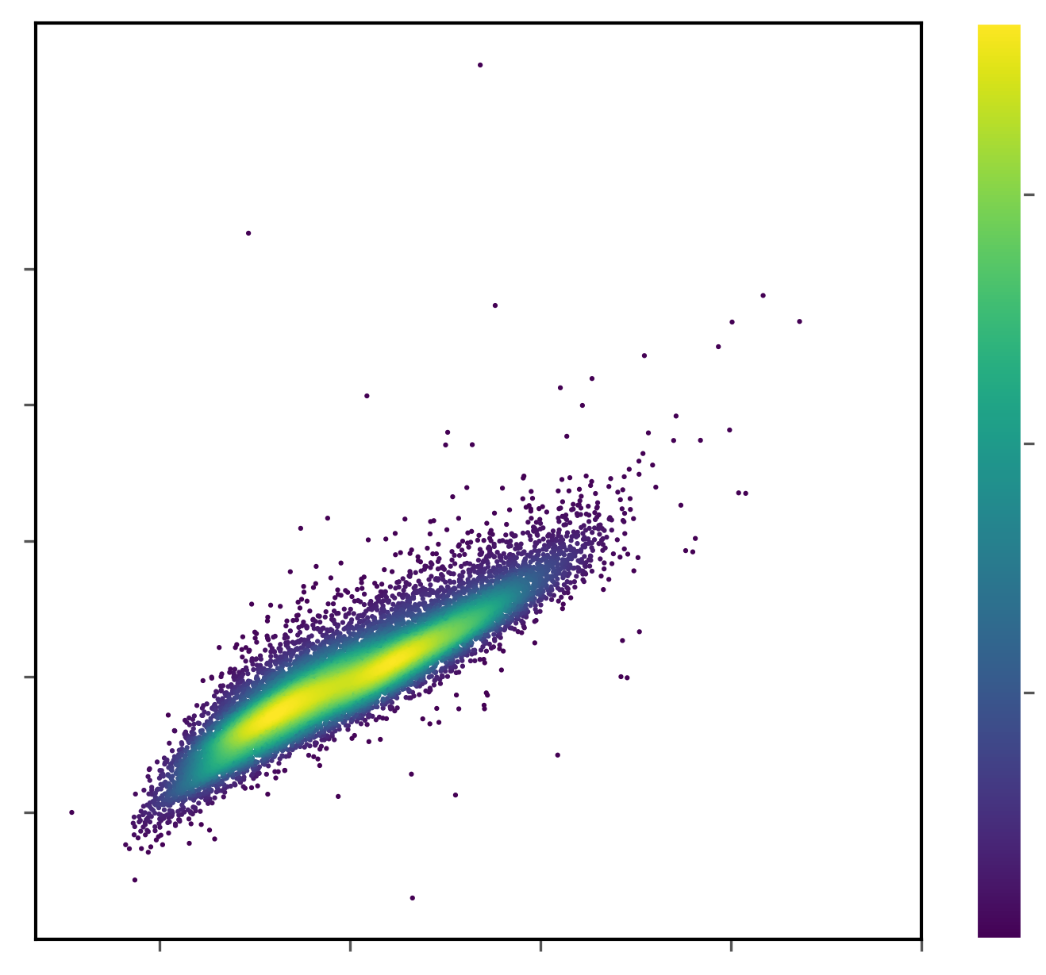
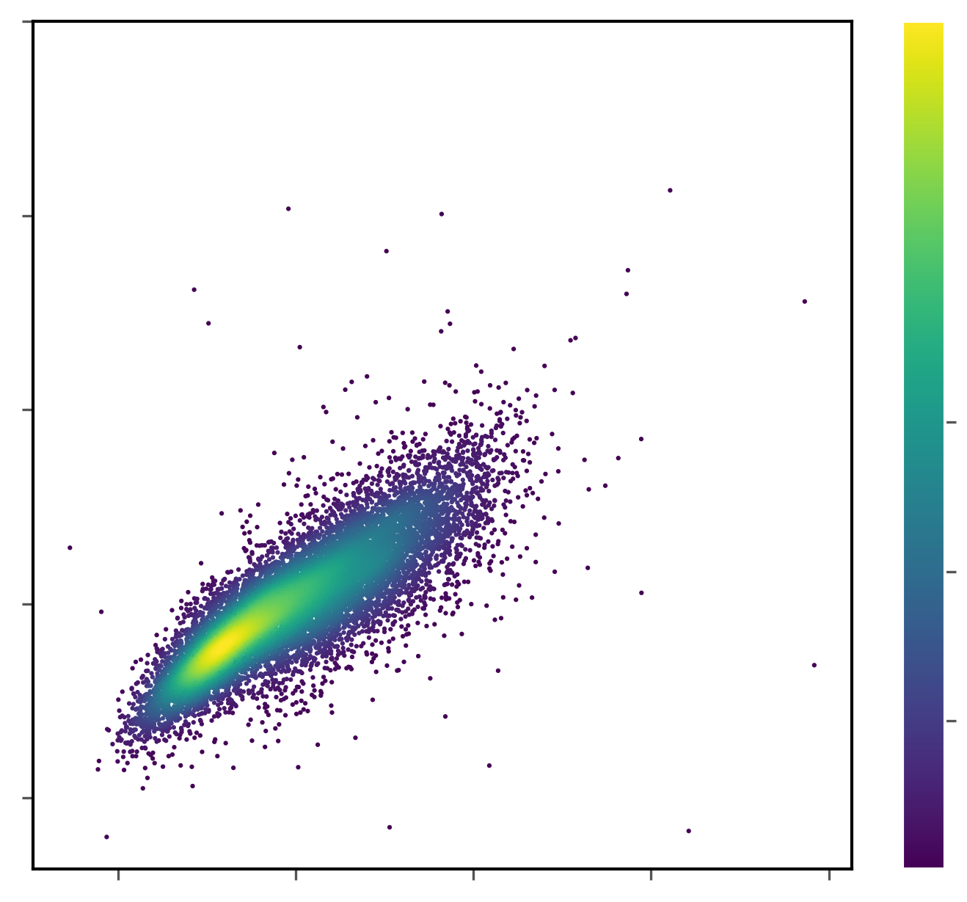
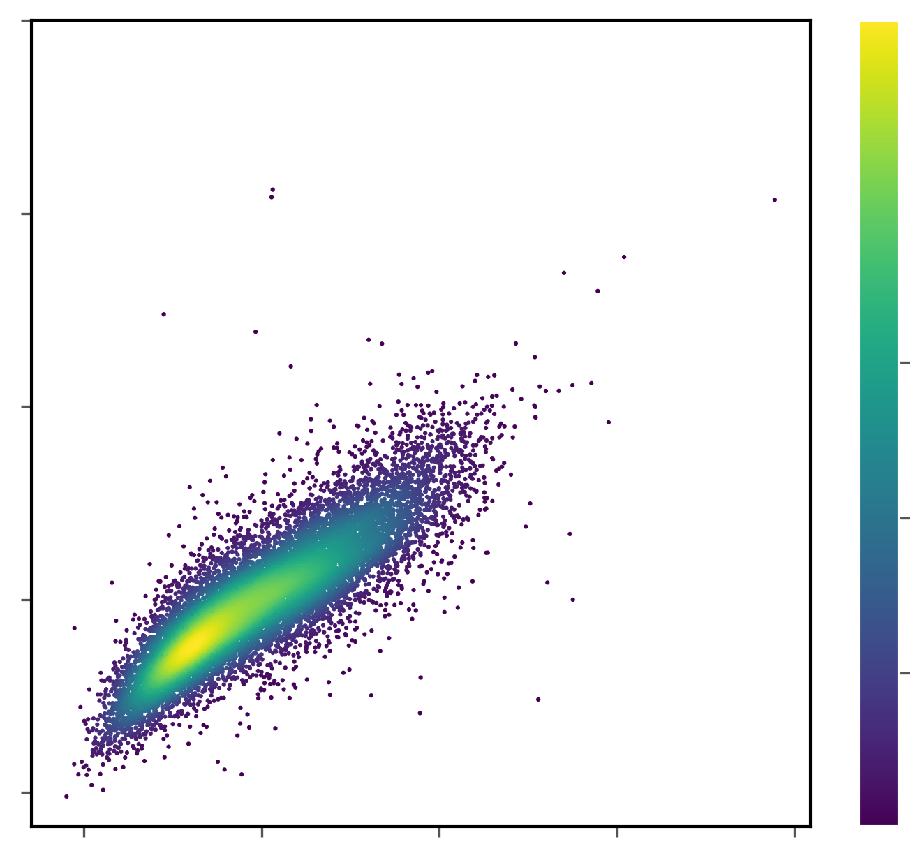
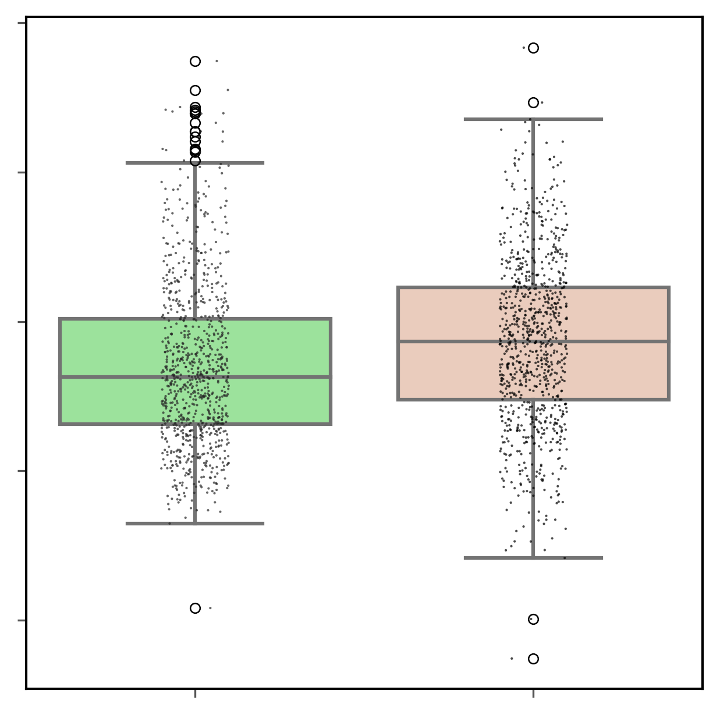
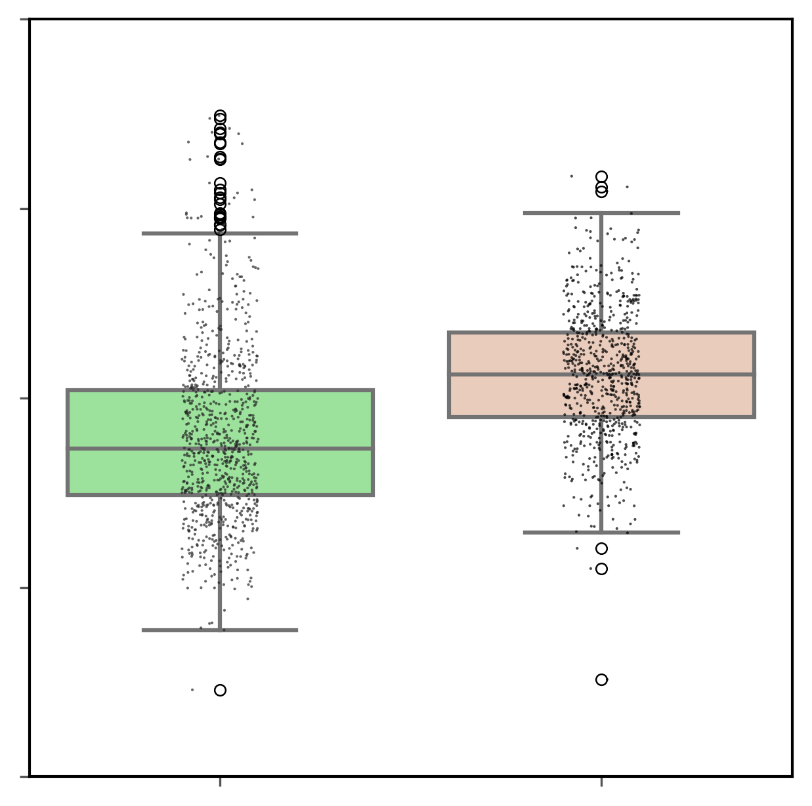

TAD level
TAD boundaries are weaker after heat shock
Scatter plot of TAD score
Scatter plot of TAD score
Scatter plot of TAD score
Spearman’s R = 0.90
K-S pvalue = 7.3e-32
Spearman’s R = 0.85
K-S pvalue = 1.1e-105
Spearman’s R = 0.86
K-S pvalue = 6.3e-81
Spearman’s
R = 0.85
H3K27me3_WT (all chroms)
-1 0 1 2 3
RNAPII_WT (all chroms)
H3K27ac_WT (all chroms)
-1 0 1 2 3
-1 0 1 2 3
1.2
0.8
0.4
-1 0 1 2 3
-1 0 1 2 3
-1 0 1 2 3
H3K27me3_HS (all chroms)
H3K27ac_HS (all chroms)
RNAPII_HS (all chroms)
p=2.7e-5
p=1.3e-17
p=3.8e-12
TAD boundaries are weaker after heat shock in all 3 factors: H3K27me3, H3K27ac, and RNAPII (Mann-Whitney U test).
TAD score
TAD score
TAD score
-1.5 -1 -0.5 0 0.5
-1.5 -1 -0.5 0 0.5
-1.5 -1 -0.5 0 0.5
WT HS
WT HS
WT HS
H3K27me3 (all chroms)
H3K27ac (all chroms)
RNAPII (all chroms)

Slide 20



TAD level
Genomic distance of chromatin interaction increases after heat shock
10⁻²
10⁻²
10⁻²
H3K27me3_WT
H3K27me3_WT
H3K27me3_WT
H3K27me3_HS
H3K27me3_HS
H3K27me3_HS
60 Kb
H3K27ac_WT
H3K27ac_WT
10⁻³
10⁻³
60 Kb
H3K27ac_HS
10⁻³
60 Kb
H3K27ac_HS
RNAPII_WT
RNAPII_HS
10⁻⁴
10⁻⁴
10⁻⁴
Corrected Hi-C counts
Corrected Hi-C counts
Corrected Hi-C counts
3 HS curves
10⁻⁵
10⁻⁵
10⁻⁵
3 WT curves
10K 100K 1M
10K 100K 1M
10K 100K 1M
Genomic distance
Genomic distance
Genomic distance
K-S test | H3K27me3_WT | H3K27me3_HS | H3K27ac_WT | H3K27ac_HS | RNAPII_WT | RNAPII_HS
H3K27me3_WT | 1
H3K27me3_HS | 8.9e-06 | 1
H3K27ac_WT | 0.97 | 4.2e-07 | 1
H3K27ac_HS | 2.5e-04 | 0.59 | 3.6e-05 | 1
RNAPII_WT | 0.59 | 7.9e-08 | 0.91 | 9.3e-07 | 1
RNAPII_HS | 2.5e-04 | 0.59 | 1.8e-05 | 1 | 2.0e-06 | 1
Genomic distance increases after heat shock;
Curves between different factors have no significant difference, but curves between WT and HS have significant difference (K-S test).
K-S test | H3K27me3_WT | H3K27me3_HS | H3K27ac_WT | H3K27ac_HS
H3K27me3_WT | 1
H3K27me3_HS | 8.92e-06 | 1
H3K27ac_WT | 0.97 | 4.2e-07 | 1
H3K27ac_HS | 2.5e-04 | 0.59 | 3.60e-05 | 1
K-S test | H3K27me3_WT | H3K27me3_HS | H3K27ac_WT | H3K27ac_HS
H3K27me3_WT | 1
H3K27me3_HS | 8.92e-06 | 1
H3K27ac_WT | 0.97 | 4.2e-07 | 1
H3K27ac_HS | 2.5e-04 | 0.59 | 3.60e-05 | 1
K-S test | H3K27me3_WT | H3K27me3_HS | H3K27ac_WT | H3K27ac_HS
H3K27me3_WT | 1
H3K27me3_HS | 8.92e-06 | 1
H3K27ac_WT | 0.97 | 4.2e-07 | 1
H3K27ac_HS | 2.5e-04 | 0.59 | 3.60e-05 | 1
K-S test | H3K27me3_WT | H3K27me3_HS | H3K27ac_WT | H3K27ac_HS
H3K27me3_WT | 1
H3K27me3_HS | 8.92e-06 | 1
H3K27ac_WT | 0.97 | 4.2e-07 | 1
H3K27ac_HS | 2.5e-04 | 0.59 | 3.60e-05 | 1
K-S test | H3K27me3_WT | H3K27me3_HS | H3K27ac_WT | H3K27ac_HS
H3K27me3_WT | 1
H3K27me3_HS | 8.92e-06 | 1
H3K27ac_WT | 0.97 | 4.2e-07 | 1
H3K27ac_HS | 2.5e-04 | 0.59 | 3.60e-05 | 1
K-S test | H3K27me3_WT | H3K27me3_HS | H3K27ac_WT | H3K27ac_HS
H3K27me3_WT | 1
H3K27me3_HS | 8.92e-06 | 1
H3K27ac_WT | 0.97 | 4.2e-07 | 1
H3K27ac_HS | 2.5e-04 | 0.59 | 3.60e-05 | 1
K-S test | H3K27me3_WT | H3K27me3_HS | H3K27ac_WT | H3K27ac_HS
H3K27me3_WT | 1
H3K27me3_HS | 8.92e-06 | 1
H3K27ac_WT | 0.97 | 4.2e-07 | 1
H3K27ac_HS | 2.5e-04 | 0.59 | 3.60e-05 | 1
K-S test | H3K27me3_WT | H3K27me3_HS | H3K27ac_WT | H3K27ac_HS
H3K27me3_WT | 1
H3K27me3_HS | 8.92e-06 | 1
H3K27ac_WT | 0.97 | 4.2e-07 | 1
H3K27ac_HS | 2.5e-04 | 0.59 | 3.60e-05 | 1
K-S test | H3K27me3_WT | H3K27me3_HS | H3K27ac_WT | H3K27ac_HS
H3K27me3_WT | 1
H3K27me3_HS | 8.92e-06 | 1
H3K27ac_WT | 0.97 | 4.2e-07 | 1
H3K27ac_HS | 2.5e-04 | 0.59 | 3.60e-05 | 1
K-S test | H3K27me3_WT | H3K27me3_HS | H3K27ac_WT | H3K27ac_HS
H3K27me3_WT | 1
H3K27me3_HS | 8.92e-06 | 1
H3K27ac_WT | 0.97 | 4.2e-07 | 1
H3K27ac_HS | 2.5e-04 | 0.59 | 3.60e-05 | 1

Slide 21






TAD level
Some TADs merge after heat shock
H3K27me3_WT (n=903)
Number
100 200 300 400
Number
Number
H3K27ac_WT (n=872)
100 200 300 400
RNAPII_WT (n=884)
100 200 300 400
H3K27me3_HS (n=893)
RNAPII_HS (n=757)
TAD number decreases after heat shock;
H3K27ac_HS (n=748)
TAD size increases after heat shock
100 200 300 400 500 600 700 800 900
100 200 300 400 500 600 700 800 900
100 200 300 400 500 600 700 800 900
A universal factor, say higher temperature, may be the primary cause of the changes (Higher temperature will reduce the overall the binding affinity and increase the random thermal dynamics).
TAD size (Kb)
TAD size (Kb)
TAD size (Kb)
100 Kb
100 Kb
100 Kb
H3K27me3_WT
H3K27ac_WT
RNAPII_WT
H3K27me3_HS
H3K27ac_HS
RNAPII_HS
Scaled density
Scaled density
Scaled density
0.0 0.2 0.4 0.6 0.8 1.0
0.0 0.2 0.4 0.6 0.8 1.0
0.0 0.2 0.4 0.6 0.8 1.0
200 600 1000
200 600 1000
200 600 1000
TAD size (Kb)
TAD size (Kb)
TAD size (Kb)
K-S test | H3K27me3_WT | H3K27me3_HS | H3K27ac_WT | H3K27ac_HS
H3K27me3_WT | 1
H3K27me3_HS | 8.92e-06 | 1
H3K27ac_WT | 0.97 | 4.2e-07 | 1
H3K27ac_HS | 2.5e-04 | 0.59 | 3.60e-05 | 1
K-S test | H3K27me3_WT | H3K27me3_HS | H3K27ac_WT | H3K27ac_HS
H3K27me3_WT | 1
H3K27me3_HS | 8.92e-06 | 1
H3K27ac_WT | 0.97 | 4.2e-07 | 1
H3K27ac_HS | 2.5e-04 | 0.59 | 3.60e-05 | 1
K-S test | H3K27me3_WT | H3K27me3_HS | H3K27ac_WT | H3K27ac_HS
H3K27me3_WT | 1
H3K27me3_HS | 8.92e-06 | 1
H3K27ac_WT | 0.97 | 4.2e-07 | 1
H3K27ac_HS | 2.5e-04 | 0.59 | 3.60e-05 | 1
K-S test | H3K27me3_WT | H3K27me3_HS | H3K27ac_WT | H3K27ac_HS
H3K27me3_WT | 1
H3K27me3_HS | 8.92e-06 | 1
H3K27ac_WT | 0.97 | 4.2e-07 | 1
H3K27ac_HS | 2.5e-04 | 0.59 | 3.60e-05 | 1
K-S test | H3K27me3_WT | H3K27me3_HS | H3K27ac_WT | H3K27ac_HS
H3K27me3_WT | 1
H3K27me3_HS | 8.92e-06 | 1
H3K27ac_WT | 0.97 | 4.2e-07 | 1
H3K27ac_HS | 2.5e-04 | 0.59 | 3.60e-05 | 1
K-S test | H3K27me3_WT | H3K27me3_HS | H3K27ac_WT | H3K27ac_HS
H3K27me3_WT | 1
H3K27me3_HS | 8.92e-06 | 1
H3K27ac_WT | 0.97 | 4.2e-07 | 1
H3K27ac_HS | 2.5e-04 | 0.59 | 3.60e-05 | 1
K-S test | H3K27me3_WT | H3K27me3_HS | H3K27ac_WT | H3K27ac_HS
H3K27me3_WT | 1
H3K27me3_HS | 8.92e-06 | 1
H3K27ac_WT | 0.97 | 4.2e-07 | 1
H3K27ac_HS | 2.5e-04 | 0.59 | 3.60e-05 | 1
K-S test | H3K27me3_WT | H3K27me3_HS | H3K27ac_WT | H3K27ac_HS
H3K27me3_WT | 1
H3K27me3_HS | 8.92e-06 | 1
H3K27ac_WT | 0.97 | 4.2e-07 | 1
H3K27ac_HS | 2.5e-04 | 0.59 | 3.60e-05 | 1

Slide 22


TAD level and gene expression
Merged boundaries appeared in RNAP2_HS are highly correlated with DEGs
chr2L:937350-1682975
chr2L:6380449-7126074
Ref genes
Ref genes
RNA-seq_WT
RNA-seq_WT
RNA-seq_HS
RNA-seq_HS
DEGs
DEGs
Loops RNAPII_WT
Loops RNAPII_WT
TADs RNAPII_WT
TADs RNAPII_WT
merged boundary
Loops RNAPII_HS
merged boundary
Loops RNAPII_HS
TADs RNAPII_HS
TADs RNAPII_HS
Chromatin states
Chromatin states
ChIP-seq H3K27ac
ChIP-seq CP190
ChIP-seq CP190
ChIP-seq BEAF
ChIP-seq BEAF

Slide 23


TAD level and gene expression
Merged boundaries appeared in RNAP2_HS are highly correlated with DEGs
chr2R:8029217-8702066
chr2R:9105777-9778626
Ref genes
Ref genes
RNA-seq_WT
RNA-seq_WT
RNA-seq_HS
RNA-seq_HS
DEGs
DEGs
logFC=-0.71
Loops RNAPII_WT
Loops RNAPII_WT
TADs RNAPII_WT
TADs RNAPII_WT
merged boundary
merged boundary
Loops RNAPII_HS
Loops RNAPII_HS
TADs RNAPII_HS
TADs RNAPII_HS
Chromatin states
Chromatin states
ChIP-seq H3K27me3
ChIP-seq H3K27me3
ChIP-seq H3K27ac
ChIP-seq H3K27ac
ChIP-seq CP190
ChIP-seq CP190
ChIP-seq BEAF
ChIP-seq BEAF

Slide 24


TAD level and gene expression
Merged boundaries appeared in RNAP2_HS are highly correlated with DEGs
***
n=50
Intersected with DEG
50
Not intersected with DEG
n=44
40
30
Boundary number
20
n=13
10
n=7
Observation
Simulation
For chr2L, there are 57 merged boundaries: 50 intersected with DEGs, 7 are not, the observed p=0.88. With the DEGs’ positions set, and randomly throwing the TAD boundary intervals, the expected probability of intersecting with a DEG, P is 0.23. We can treat it as a binomial test, and calculate the z score as 11.25, whose p vaue is close to 0. The conclusion still holds for all chromosomes.
Go analysis of 492 DEGs located in merged boundaries of all chromosomes

Slide 25


Promoter-marked TAD boundary usually has H2H/T2T with one gene up-regulated and another gene down-regulated after heat shock
TAD level and gene expression
chr2L:1893001-2154496
Distance between TSS/TES
Ref genes
RNA-seq_WT
Head-to-head (H2H)
RNA-seq_HS
DEGs
TADs H3K27me3_WT
TADs H3K27me3_HS
Pomoter and TSS
Chromatin states
Tail-to-tail (T2T)
ChIP-seq H3K27me3
ChIP-seq H3K27ac
ChIP-seq CP190
Adapted from Tu et al., PeerJ. 2019
ChIP-seq BEAF

Slide 26


Promoter-marked TAD boundary usually has H2H/T2T with one gene up-regulated and another gene down-regulated after heat shock
TAD level and gene expression
chr2L:2049901-2311396
chr2L:4377251-4638746
Ref genes
Ref genes
RNA-seq_WT
RNA-seq_WT
RNA-seq_HS
RNA-seq_HS
DEGs
DEGs
TADs H3K27me3_WT
TADs H3K27me3_WT
TADs H3K27me3_HS
TADs H3K27me3_HS
Pomoter and TSS
Pomoter and TSS
Chromatin states
Chromatin states
ChIP-seq H3K27me3
ChIP-seq H3K27me3
ChIP-seq H3K27ac
ChIP-seq H3K27ac
ChIP-seq CP190
ChIP-seq CP190
ChIP-seq BEAF
ChIP-seq BEAF

Slide 27


Promoter-marked TAD boundary usually has H2H/T2T with one gene up-regulated and another gene down-regulated after heat shock
TAD level and gene expression
chr2L:716251-977746
chr2L:9074784-9471791
logFC=-0.6
Ref genes
Ref genes
logFC=0.7
RNA-seq_WT
RNA-seq_WT
RNA-seq_HS
RNA-seq_HS
DEGs
DEGs
TADs H3K27me3_WT
TADs H3K27me3_WT
TADs H3K27me3_HS
TADs H3K27me3_HS
Pomoter and TSS
Pomoter and TSS
Chromatin states
Chromatin states
ChIP-seq H3K27me3
ChIP-seq H3K27me3
ChIP-seq H3K27ac
ChIP-seq H3K27ac
ChIP-seq CP190
ChIP-seq CP190
ChIP-seq BEAF
ChIP-seq BEAF

Slide 28


Promoter-marked TAD boundary usually has H2H/T2T with one gene up-regulated and another gene down-regulated after heat shock
TAD level and gene expression
A
B
150
n=145
100
n=99
P-marked
Non-P
100
Boundary number
50
n=46
n=45
Boundary number
50
n=23
n=23
n=3
n=8
P-marked
Non-P
Co-regulated
Up-down
Unexpressed
For chr2L, there are 202 boundaries, 145 (72%) are promoter-marked boundaries (P-marked);
In the all P-marked boundaries, boundaries with label ‘up-down’ are 68%.
Up-down one gene of H2H/T2T is up-regulated and another down-regulated
Co-regulated both genes of H2H/T2T are up-regulated or down-regulated
Un-expressed at least one gene is not expressed

Slide 29









Loop level
Charateristics of ChIA-PET loops of different libs
All loops with PET count>=2
H3K27me3_WT
H3K27me3_HS
0.8
H3K27me3_WT
1K
1K
H3K27me3_HS
0.6
100
100
Density
PET count
PET count thresh = 5
PET count
0.4
10
10
0.2
2
2
1K 10K 100K 1M 10M
1K 10K 100K 1M 10M
1K 10K 100K 1M 10M
Loop span
Loop span
Loop span
All loops with PET count>=2
0.8
Loops with PET count < 5 are treated as background, while loops with PET count >= 5 are treated as real interaction;
The proportion of long loop span increases after heat shock.
H3K27ac_WT
H3K27ac_WT
1K
H3K27ac_HS
0.6
H3K27ac_HS
1K
Density
PET count
PET count
0.4
100
100
10
10
0.2
2
2
1K 10K 100K 1M 10M
1K 10K 100K 1M 10M
1K 10K 100K 1M 10M
Loop span
Loop span
Loop span
All loops with PET count>=2
0.8
1K
RNAPII_WT
1K
RNAPII_HS
RNAPII_WT
0.6
RNAPII_HS
100
100
Density
PET count
PET count
0.4
10
10
0.2
2
2
1K 10K 100K 1M 10M
1K 10K 100K 1M 10M
1K 10K 100K 1M 10M
Loop span
Loop span
Loop span

Slide 30






Loop level
Charateristics of ChIA-PET loops of different libraries
All loops with PET count < 5
All loops with PET count < 5
All loops with PET count < 5
0.8
0.8
0.8
H3K27me3_WT
H3K27ac_WT
RNAPII_WT
0.6
H3K27me3_HS
0.6
H3K27ac_HS
0.6
RNAPII_HS
Density
Density
Density
0.4
0.4
0.4
0.2
0.2
0.2
For loops with PET count <5,
The proportion of long loop span increases after heat shock.
For loops with PET count >=5,
The proportion of long loop span obviously increases after heat shock in both H3K27ac and RNAPII, but not in H3K27me3.
1K 10K 100K 1M 10M
1K 10K 100K 1M 10M
1K 10K 100K 1M 10M
Loop span
Loop span
Loop span
All loops with PET count >= 5
All loops with PET count >= 5
All loops with PET count >= 5
1
0.8
H3K27me3_WT
1
H3K27ac_WT
RNAPII_WT
H3K27me3_HS
H3K27ac_HS
RNAPII_HS
Density
0.8
1
0.6
Density
Density
0.6
0.8
0.4
0.6
0.4
0.2
0.4
0.2
0.2
1K 10K 100K 1M 10M
1K 10K 100K 1M 10M
1K 10K 100K 1M 10M
Loop span
Loop span
Loop span

Slide 31
Loop level
Classify the loops into 3 categories in all 3 groups (H3K27me3, H3K27ac, RNAPII)
Category
WT_shared
WT_shared_one_anchor
WT_shared_zero_anchor
WT
HS
Category
HS_shared
HS_shared_one_anchor
HS_shared_zero_anchor

Slide 32




Loop level
Scatterplot of loops with PET count >=5 in 3 categories in H3K27ac and RNAPII
H3K27ac_WT
H3K27ac_HS
RNAPII_WT
RNAPII_HS
WT_shared_one_anchor
n=26004
HS_shared_one_anchor
n=24194
WT_shared_one_anchor
n=29405
HS_shared_one_anchor
n=16358
1K
1K
1K
1K
100
100
100
100
PET count
PET count
PET count
PET count
10
10
10
10
5
5
5
5
1K 10K 100K 1M
1K 10K 100K 1M
1K 10K 100K 1M
1K 10K 100K 1M
Loop span
Loop span
Loop span
Loop span
WT_shared_zero_anchor
n=13284
HS_shared_zero_anchor
n=1565
WT_shared_zero_anchor
n=13718
HS_shared_zero_anchor
n=2110
1K
1K
1K
1K
PET count
PET count
100
PET count
100
100
PET count
100
10
10
10
10
5
5
5
5
1K 10K 100K 1M
1K 10K 100K 1M
1K 10K 100K 1M
1K 10K 100K 1M
Loop span
Loop span
Loop span
Loop span
WT_shared
n=13982
HS_shared
n=13982
WT_shared
n=9412
HS_shared
n=9412
1K
1K
1K
1K
PET count
PET count
100
PET count
PET count
100
100
100
10
10
10
10
5
1K 10K 100K 1M
5
5
5
Loop span
1K 10K 100K 1M
1K 10K 100K 1M
1K 10K 100K 1M
Loop span
Loop span
Loop span

Slide 33


Loop level
Scatterplot of loops with PET count >=5 in 3 categories in H3K27me3 and H3K27ac
H3K27me3_WT
H3K27me3_HS
H3K27ac_WT
H3K27ac_HS
WT_shared_one_anchor
n=59321
HS_shared_one_anchor
n=50804
WT_shared_one_anchor
n=26004
HS_shared_one_anchor
n=24194
1K
1K
1K
1K
100
100
PET count
PET count
100
100
PET count
PET count
10
10
5
5
1K 10K 100K 1M
10
10
1K 10K 100K 1M
Loop span
5
5
Loop span
1K 10K 100K 1M
1K 10K 100K 1M
Loop span
Loop span
WT_shared_zero_anchor
n=2758
HS_shared_zero_anchor
n=2728
WT_shared_zero_anchor
n=13284
HS_shared_zero_anchor
n=1565
1K
1K
1K
1K
100
100
PET count
PET count
PET count
100
PET count
100
10
10
5
5
10
10
1K 10K 100K 1M
1K 10K 100K 1M
5
5
Loop span
Loop span
1K 10K 100K 1M
1K 10K 100K 1M
Loop span
Loop span
WT_shared
n=28021
HS_shared
n=28021
WT_shared
n=13982
HS_shared
n=13982
1K
1K
1K
1K
100
100
PET count
PET count
PET count
PET count
100
100
10
10
10
10
5
5
1K 10K 100K 1M
5
5
1K 10K 100K 1M
Loop span
1K 10K 100K 1M
1K 10K 100K 1M
Loop span
Loop span
Loop span

Slide 34

Loop level
Newly formed loops with large loop span and low PET counts induced by heat shock in H3K27ac and RNAPII usually connect interaction domains
chr2L:14899489-16346700
Ref genes
RNA-seq_WT
RNA-seq_HS
DEGs
Loops
H3K27me3_WT
Loops
H3K27me3_HS
Loops
H3K27ac_WT
Loops
H3K27ac_HS
Loops
RNAPII_WT
Loops
RNAPII_HS
ChIP_H3K27me3
ChIP_H3K27ac

Slide 35

Loop level
Loops with large loop span and low PET counts induced by heat shock in H3K27ac and RNAPII are connecting interaction domains
chr2L:16473838-19264497
Is it related to the condensation induced by heat shock? What’s the function in gene expression and regulation
Ref genes
RNA-seq_WT
RNA-seq_HS
DEGs
Loops
H3K27me3_WT
Loops
H3K27me3_HS
Loops
H3K27ac_WT
Loops
H3K27ac_HS
Loops
RNAPII_WT
Loops
RNAPII_HS
ChIP_H3K27me3
ChIP_H3K27ac

Slide 36
Next plan
Loop level
Interaction domain
1. Call the interaction domains and describe the features
(After heat shock, Interaction strength BETWEEN interaction domains in H3K27ac and RNAPII obviously increase, but not in H3K27me3)
2. Is it related with the condesation induced by heat shock.
3. Is it related with gene expression and regulation
Shared_zero_anchor
1. Loops with large loop span and low PET counts induced by heat shock in H3K27ac and RNAPII usually connect clusters. (Interaction domains)
3 categories
Shared
Shared_one_anchor
Shared_zero_anchor
Shared
1. Only consider PET count change.
2. Extent of PET count drop: RNAPII > H3K27me3 > H3K27ac
3. Is it related to the gene expression and regulation?
3 groups
H3K27me3
H3K27ac
RNAPII
Shared_one_anchor
1. Similar to loop extrusion model.
2. Is it related to the gene expression and regulation.
3. If yes, is it also related with epigenetic modification (H3K27me3 and H3K27ac)
A model of Dynamic 3D structure and gene regulation of Drosophila under heat stress

Slide 37
Summary
Dynamic 3D structure and gene regulation of Drosophila under heat stress
Level
Feature discription
Relationship with gene expression and regulation
Compartments
1. Compartment pattern of H3K27me3 is block-like, more similar to that of Hi-C, while that of H3K27ac is stripe-like, more similar to that of RNAPII.
2. Compartment strength has no significant change after heat shock.
1. Most DEGs and unregulated genes are located in A compartments.
TADs
1. TAD boundaries weaken after heat shock.
2. Genomic distance increases after heat shock.
3. After heat shock, TADs merge, TAD’size increases, and TAD’s number decreases.
4. The changes show no significant difference between different factors and chromosomes, indicating higher temperature may be the primary cause.
1. Merged boundaries appeared in RNAP2_HS are highly correlated with DEGs. Go analysis shows that these DEGs are stress and RNA related.
2. Promoter-marked TAD boundary usually has H2H/T2T with one gene up-regulated and another gene down-regulated after heat shock
Interaction domains
1. Loops with large loop span and low PET counts induced by heat shock in H3K27ac and RNAPII usually connect interaction domains. Need further analysis.
Need further analysis
Loops
1. Classify the loop into 3 categories, and describe some features. Need further analysis.
Need further analysis

Slide 38
Acknowledgement
Meizhen Zheng
Zhongyuan Tian
Duo Ning
Yewen Xu
Kai Jing
Yang Yang
Guangyu Huang
Yuqing Deng
Gengzhan Chen
Tong Gao
Wenxin Wang
Zhimin Zhang

Slide 39
Thank you for your attention!

